Slide 1
Strategies For Successful Choral Sight Reading
Troy Bashor, Morgan Jones
and Jessica Franks

Slide 2
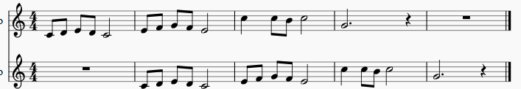
Solfege Warm-Ups

Slide 3
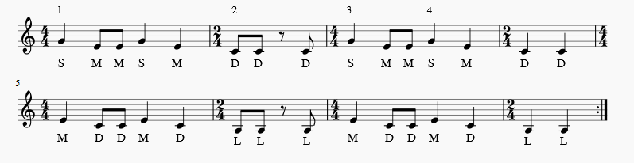
Credit: Elizabeth Emigh

Slide 4

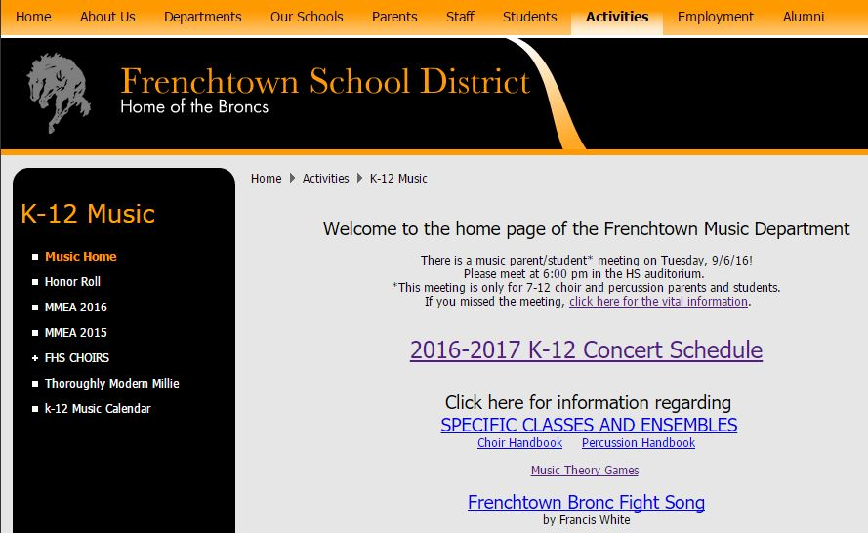

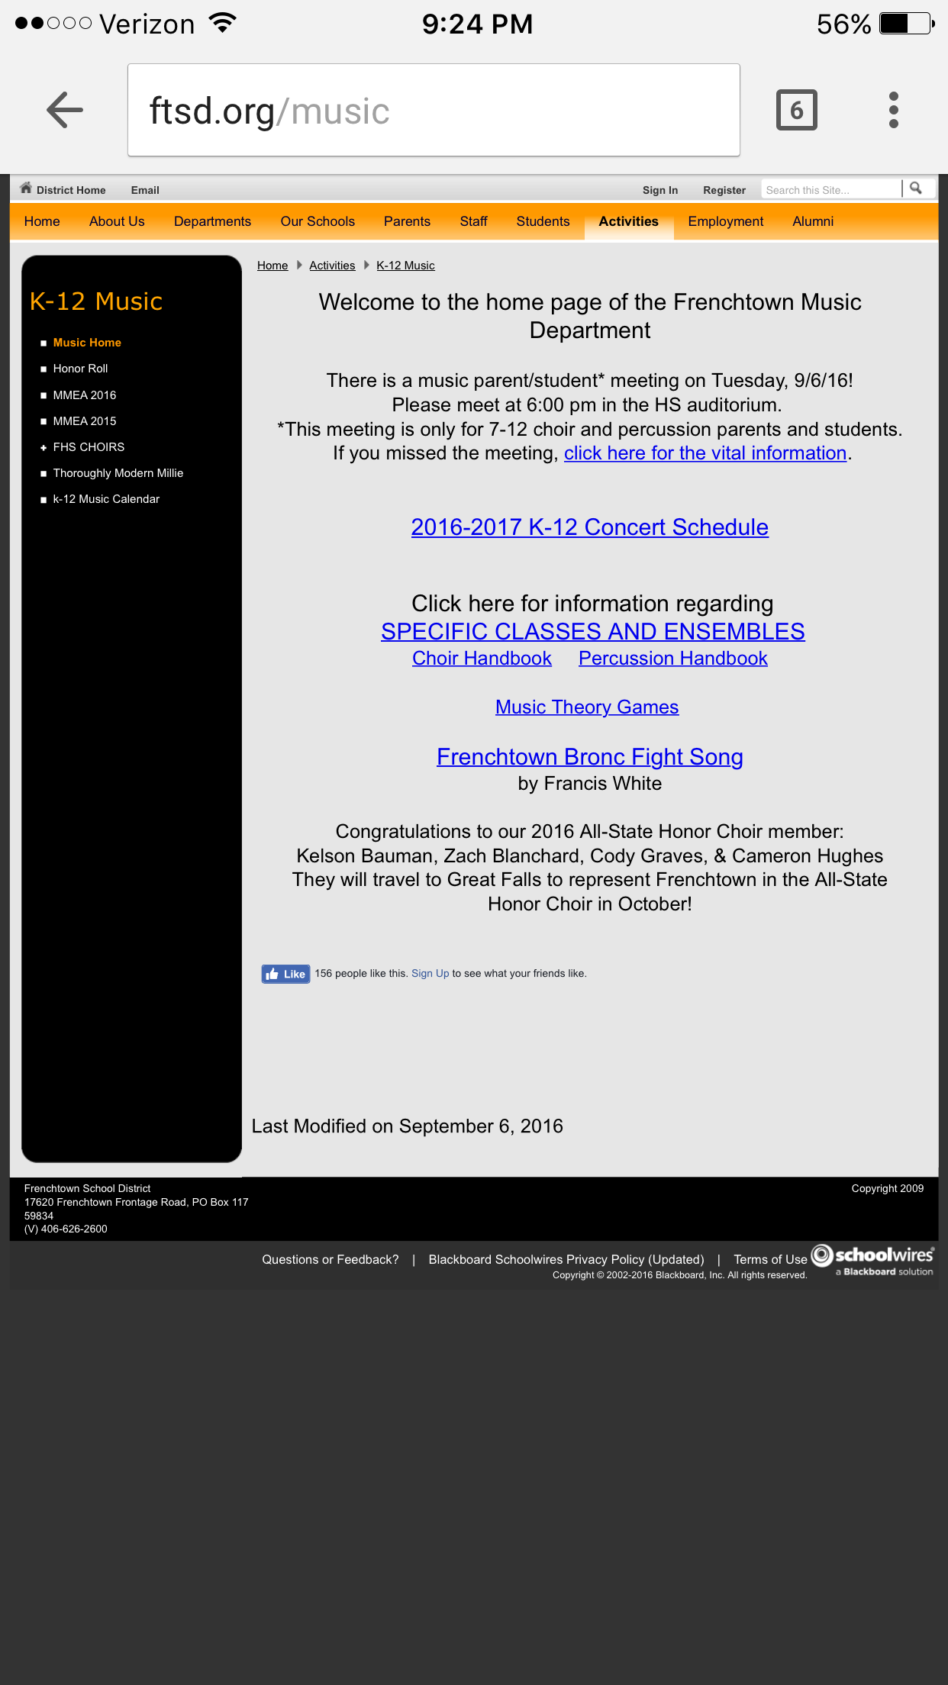
Want to find this information later?
www.ftsd.org/music
Then click MMEA 2016

Slide 5
About Us
Jessica teaches choir, AP Music Theory, and the school musical at Sentinel HS in Missoula. She has a bachelor’s in Music Education from West Virginia University and a master’s in Fine Arts from UM.
Morgan teaches the middle school and high school choirs at Florence-Carlton School in the Bitterroot Valley. She has a Bachelor’s in Music Education and a Master’s in Vocal Performance.
Troy teaches junior high choirs, high school choirs, AP Music Theory, high school percussion ensemble, theater and stage crafting in Frenchtown. He has his Bachelor’s and Master’s of Music Education from the University of Montana.

Slide 6

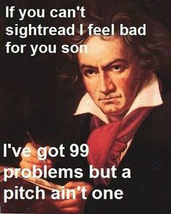



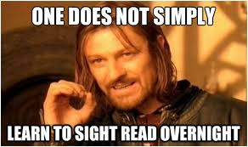

Slide 7
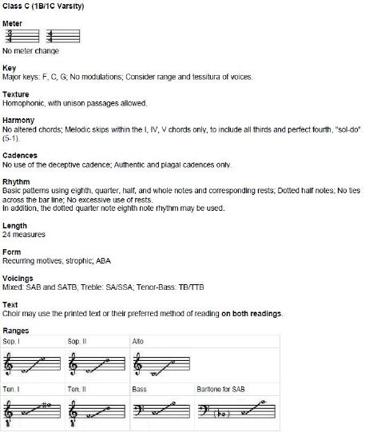
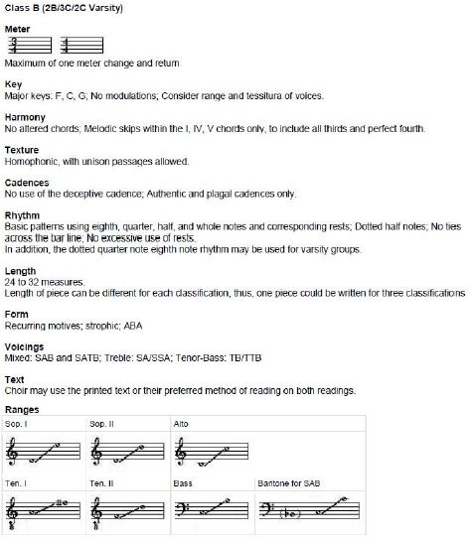

Slide 8
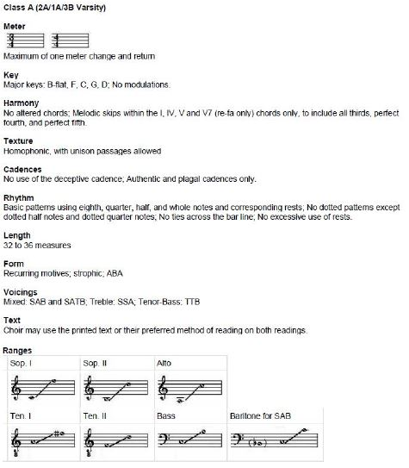
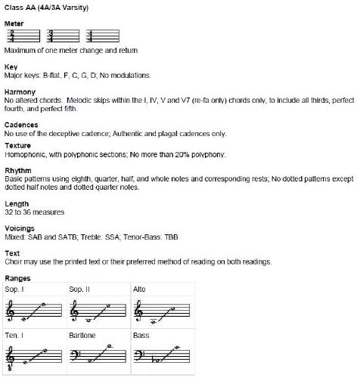

Slide 9
Video examples

Slide 10
Helpful Links to Videos
8th gr Girls's Choir from south Texas Just because a choir may not be at this level, doesn’t mean we can’t keep it in mind and know what’s possible. We work to meet our kids where they are and then take them to a level that they couldn’t reach on their own.
FHS Chamber Chorale
https://youtu.be/AqBlMU9rS38
Frenchtown 7th Grade
https://youtu.be/aBAshmZCnJU

Slide 11
The process

Slide 12
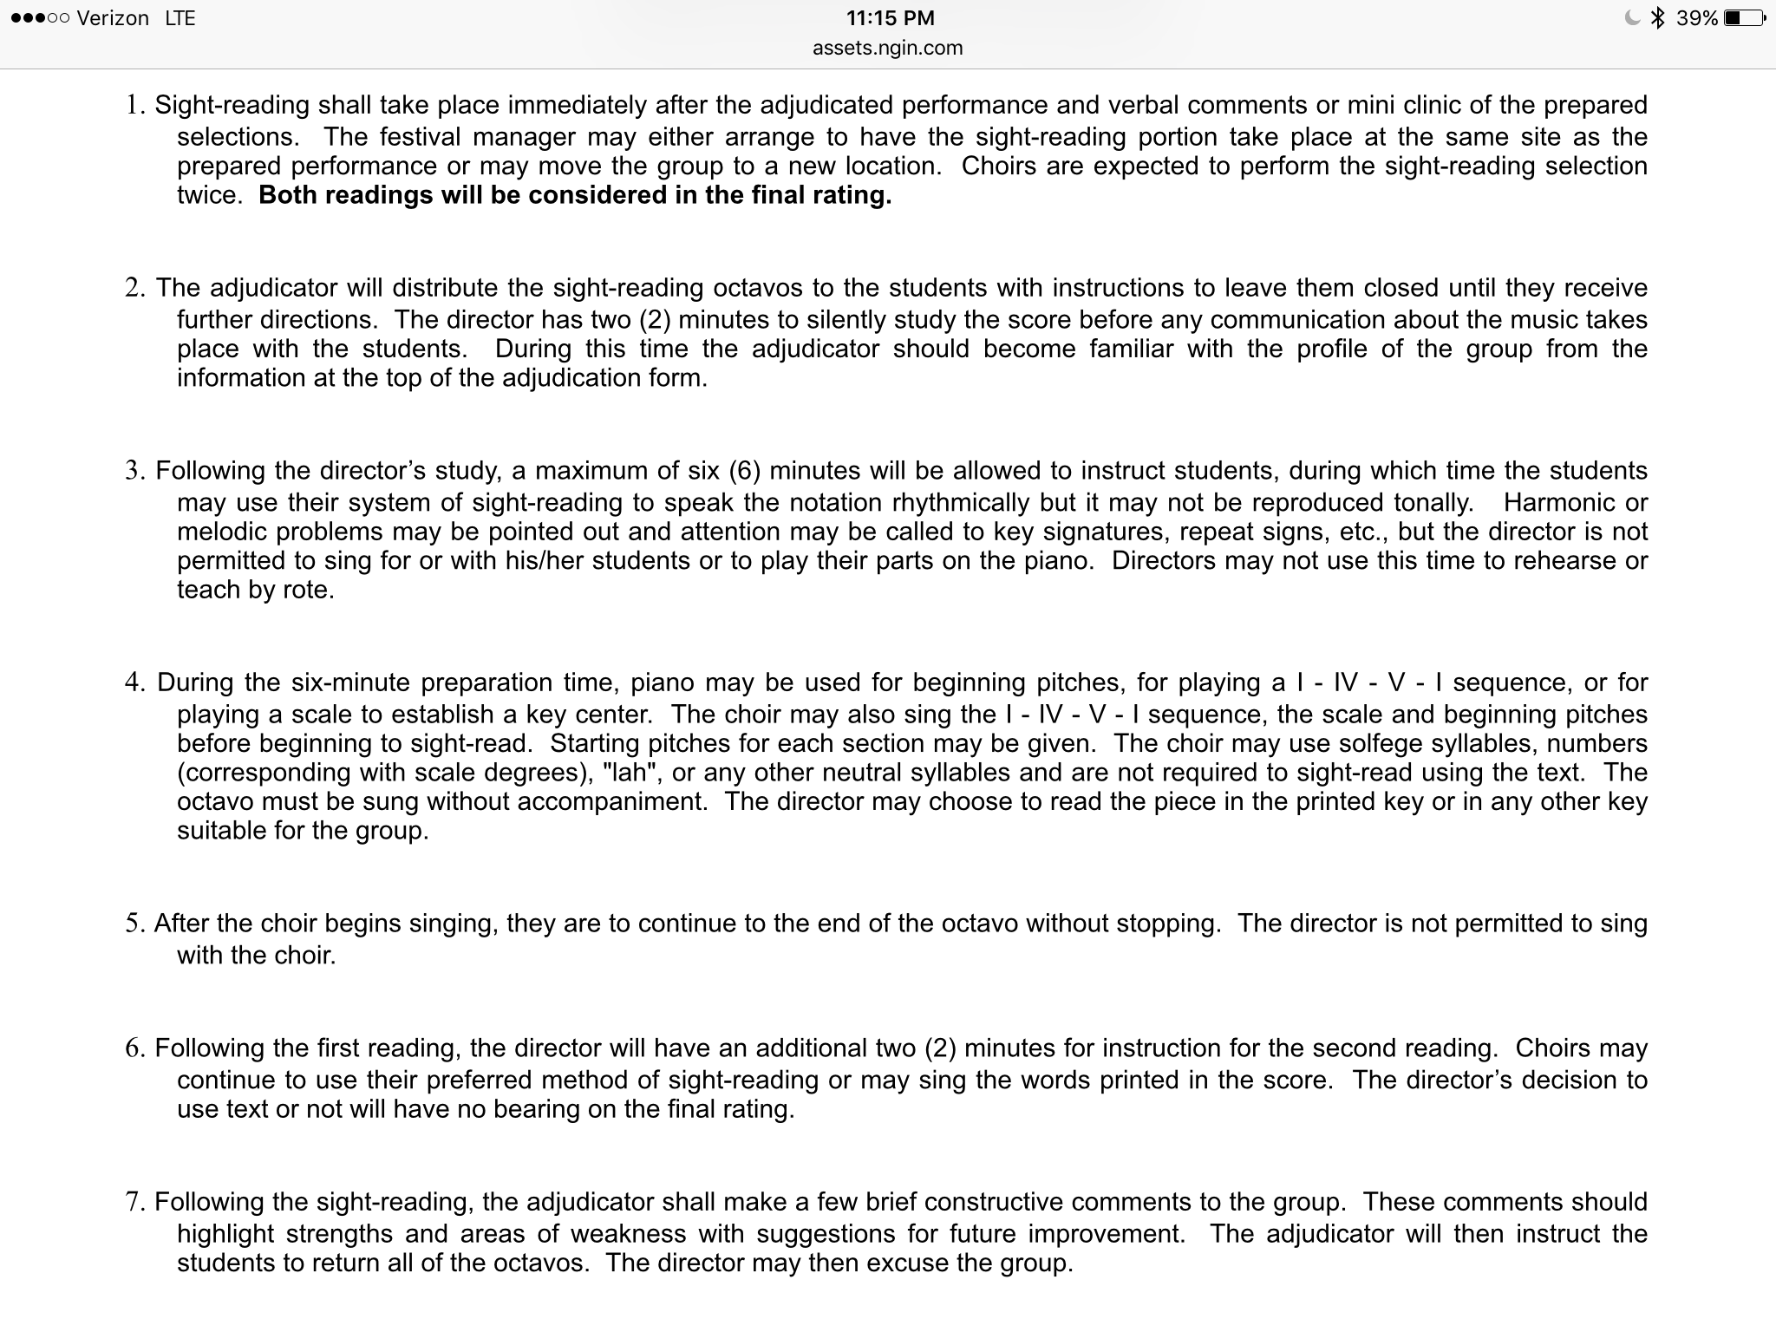

Slide 13
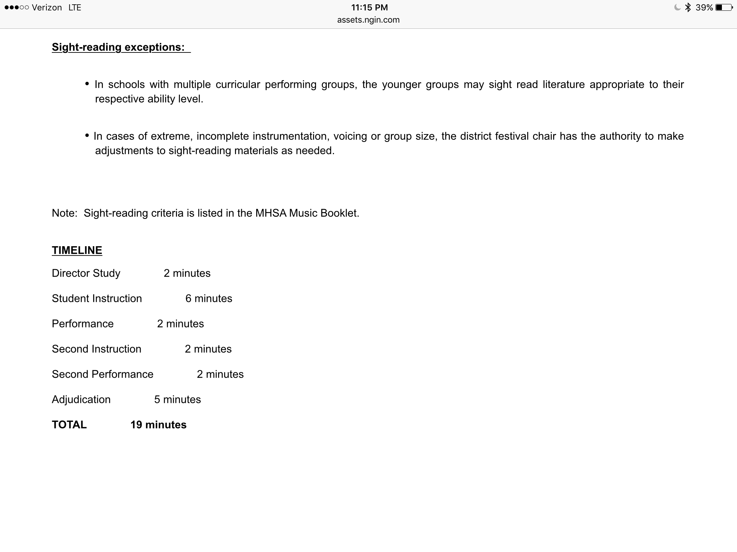

Slide 14
Audiate
Chant
Section leaders
Questions

Slide 15
Larger Schools
Troy’s Process:
6 minutes:
Audiate 1 minute alone
Group Chant once through
Section leaders point out tricky spots and fix
Last thoughts
Do-mi-sol-mi-do-sol-do
Sing starting chord
First attempt
2 minutes:
My observations
audiate/chant/fix
Second attempt

Slide 16
Smaller Schools
Morgan’s Process:
Director’s Notes/Tips
Sing a scale
Audiate
Sing
Isolate & Fix
Sing Again
https://youtu.be/xdpCdP0SbBM

Slide 17
Sight Singing in Middle School
Introduce solfege with simple unison melodies.
Do some sort of solfege activity every day.
Insist that students use hand signs.
Find ways to make solfege more FUN!

Slide 18
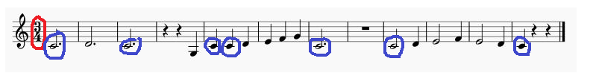
Written exercises on the board...
https://youtu.be/NuukyHPJOxU

Slide 19

Student Poetry = Great Lyrics

Slide 20
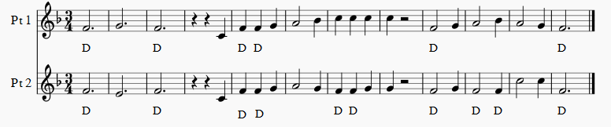
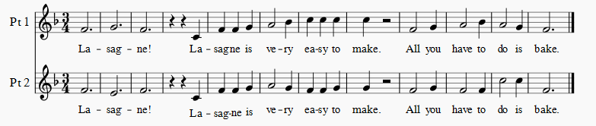

Slide 21
Tips for success

Slide 22
If possible, display sight singing materials with an overhead or SmartBoard.
2. With beginning students, start with simple unison melodies.
3. Encourage students to pick one or two hand signs to show if they can’t do them all. They can gradually add more and more signs as they progress.
4. Teach key signatures!
5. Use Solfege in literature in rehearsal. Sub plans!!
6. Use multiple systems.
7. Can you share a helpful tip with us?

Slide 23
Assessment

Slide 24
Use your literature!
Take a section they know well and switch to Solfege.
Solfege another section’s part.
Write in the key(s) and indicate Do.
Sing only when you have ________ syllable.
Sing only when you have two notes that skip a 3rd/4th,etc
Solfege a line backwards.
Kids sing one part, teacher sings another.
Use written prompts as the basis for tests or sub plans.

Slide 25
Written Prompt Examples for Written Assessment
Put your first/last name on the top right of p.2.
Zigzag underline the original lyricist.
Bubble underline the composer.
Circle your voice part.
Write the key above your first treble clef.
Circle around the note + word for any Do.
Triangle around the note + word for any Sol.
Write the correct Solfege syllable under the first note you sing in each measure. (And countless other ideas!)

Slide 26
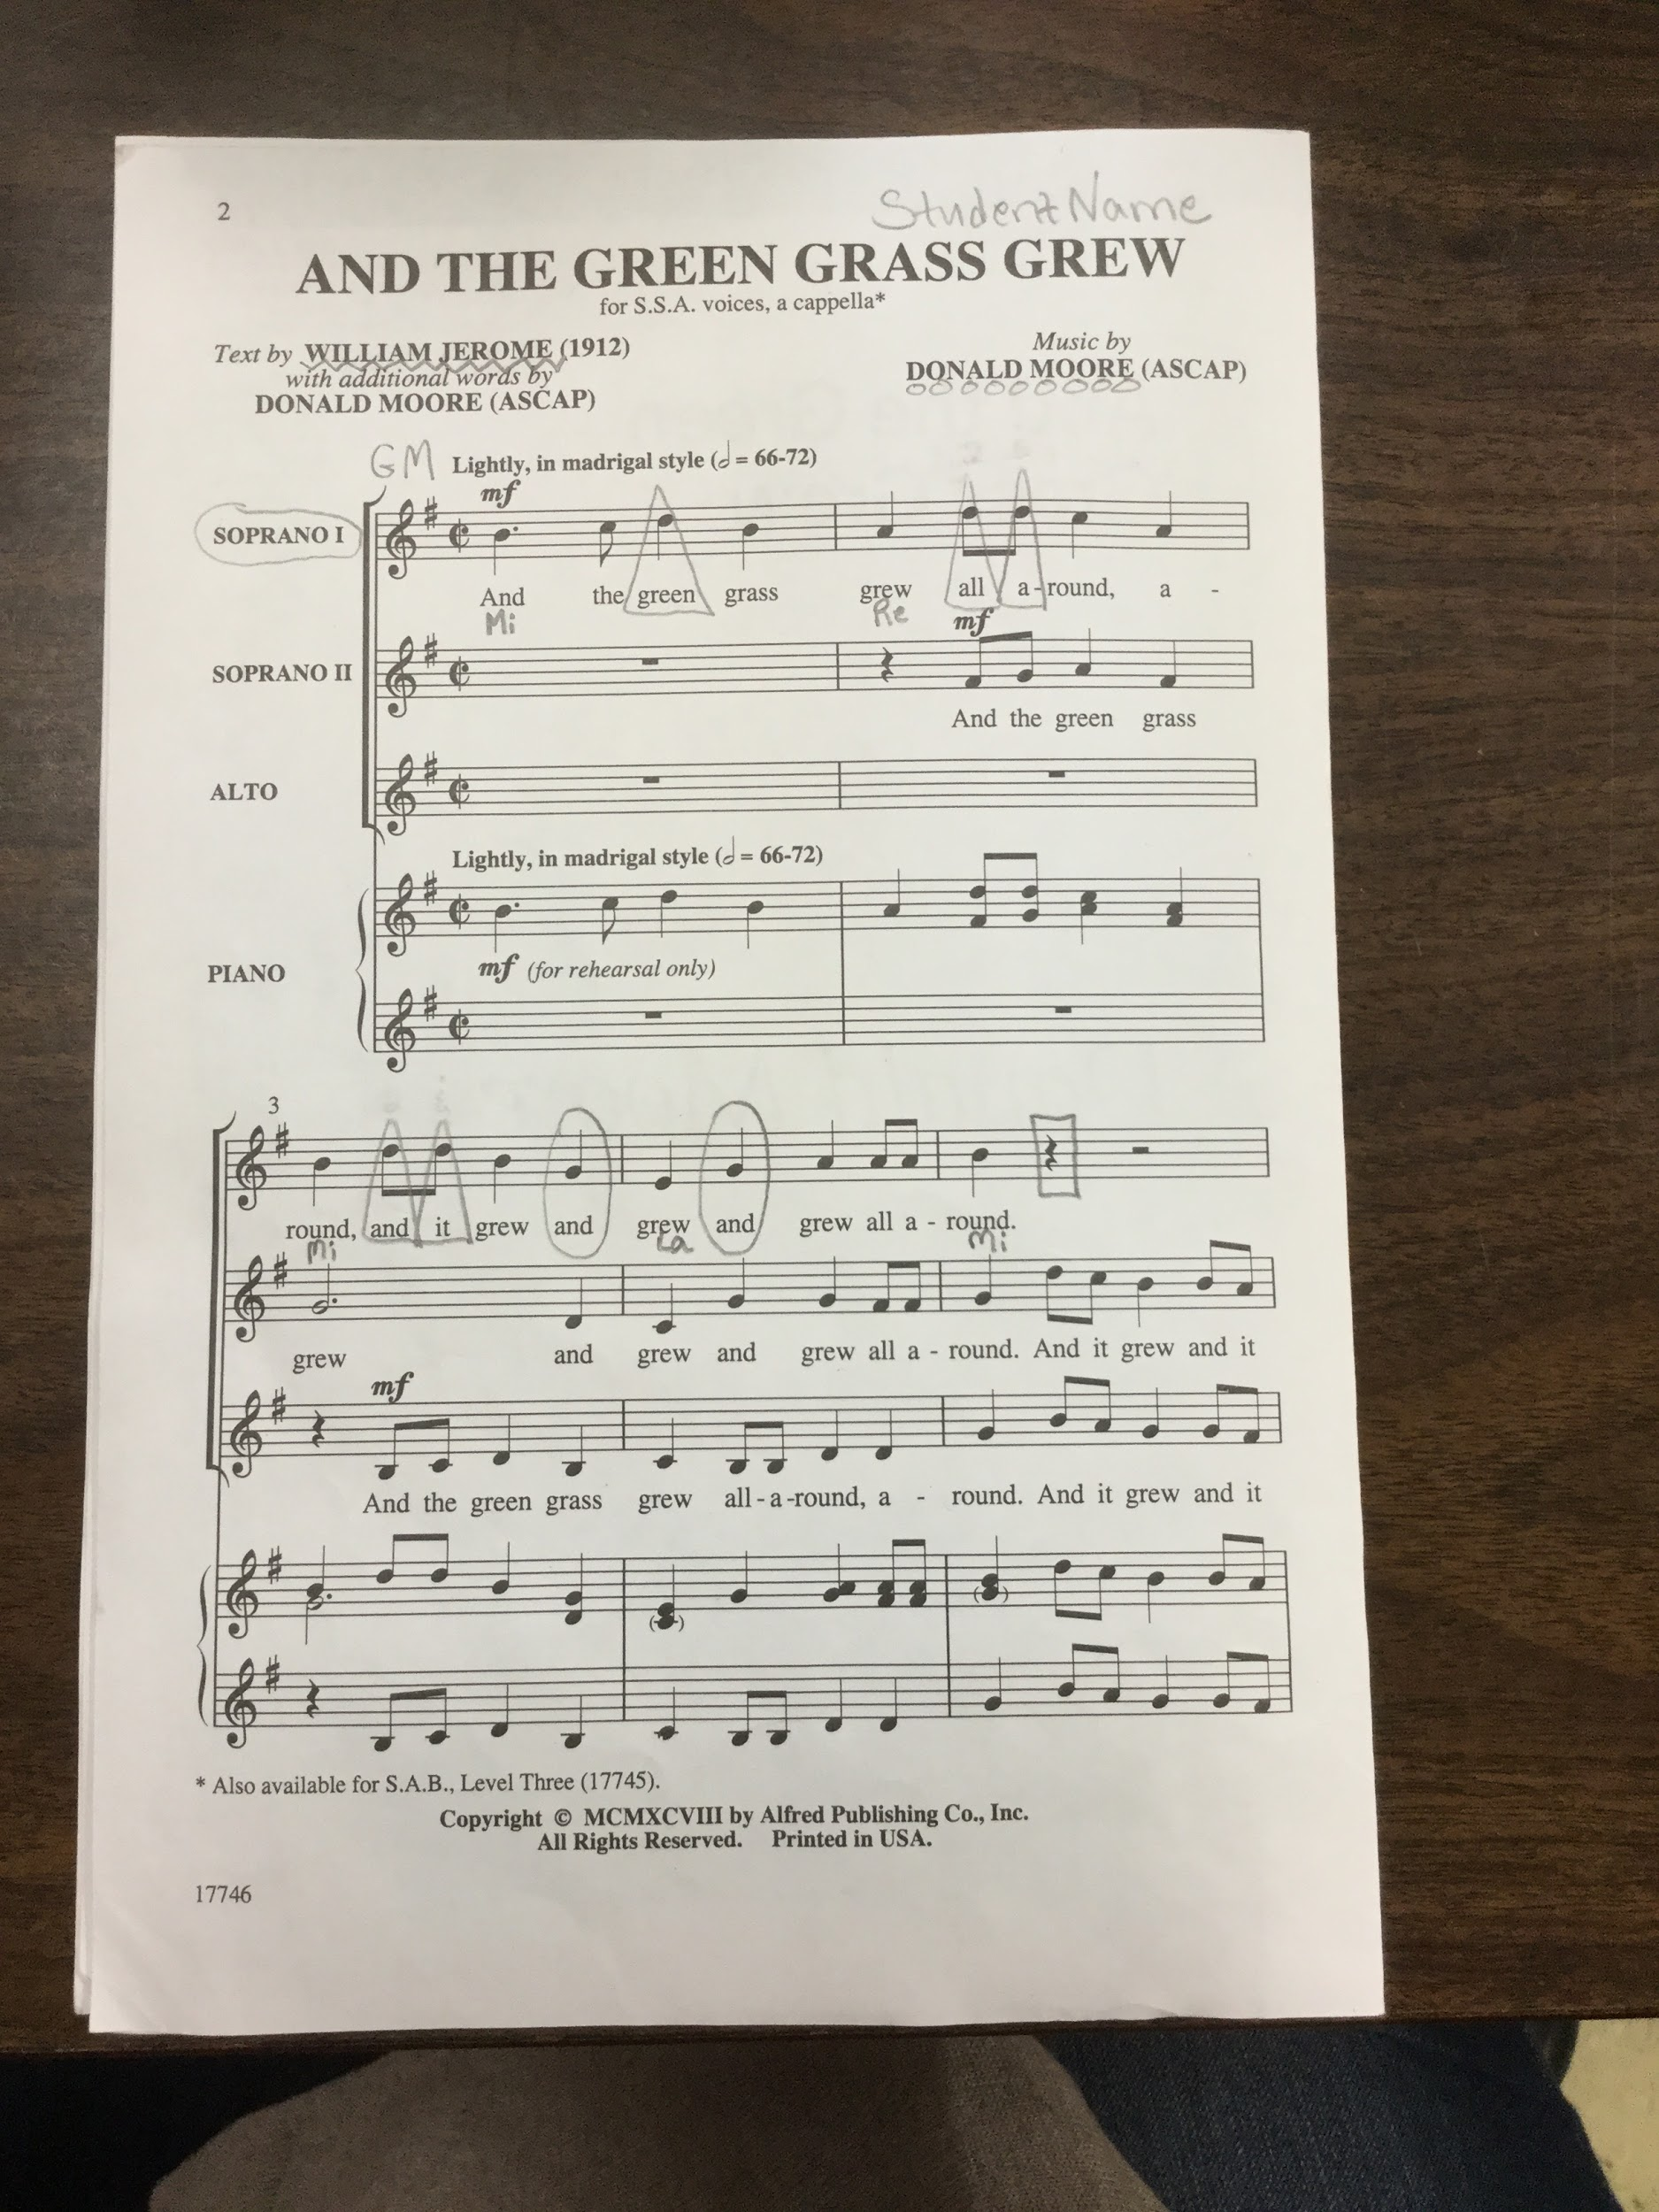

Slide 27
Planning for Video/Audio Assessment
Keep it manageable.
Use group assessments first, then solo later.
Use your literature.
Train a student to give starting pitches.
Give them a time limit.
Ideas for absent kiddos?
Need one device to record, and one to give pitches or play a prompt track.
The recorder is also the poster.

Slide 28
Written Prompt Examples for Recorded Assessment
You have 10 minutes to practice AND record. Must be posted/returned by 5pm. Designate someone to record, give pitch, be starter.
Turn to pg. ___ in your music.
Determine the key and sing the triad pattern.
Chant syllables in rhythm.
Review tricky parts.
Start recording.
Play Do. Sing triad pattern. Sing starting pitch.
Count off one measure and perform in Solfege.

Slide 29
Resources

Slide 30
SightReadingFactory.com
https://www.sightreadingfactory.com/
Promo Code for 20% off a subscription (Exp. Nov 15, 2016)
mmea1617

Slide 31
Melodia (an old sight singing book)
Melodia

Slide 32
Theta Music Trainer
https://trainer.thetamusic.com/

Slide 33
Noteflight
https://ap-music-theory-16-17.sites.noteflight.com/
Request a free demo

Slide 34
Toned Ear
http://tonedear.com/

Slide 35
The Practice Room
http://www.thepracticeroom.net/login.php

Slide 36
Teoria
https://www.teoria.com/en/exercises/

Slide 37
Contact or more pages
Troy Bashor
Frenchtown High School
troybashor@gmail.com
www.ftsd.org/music
Morgan Jones
Florence-Carlton High School
jonesm@florence.k12.mt.us
http://www.florence.k12.mt.us/Domain/148
Jessica Franks
Sentinel High School
jfranks@mcpsmt.org
sentinelchoirs.blogspot.com

