Slide 1
REWRITING MUSIC - When, Why and How
MMEA CONFERENCE
October 22, 2016
Jeff Skogley & Nancy McPherson

Slide 2
When should you rewrite the music for your band?
Important lines are missing
Important harmonies are missing
Lines are too difficult for some sections
Lines are not challenging enough
Be cognizant of when it is appropriate
Festivals vs home concerts

Slide 3
Why go to all that work?
It will produce a more musical performance
Musicians and audience will be more satisfied with what they hear
Since you can’t make the music work as written, do what the composer might have done if presented with your instrumentation and musicians

Slide 4
How do I rewrite the music?
Don’t start from scratch, use the parts that already exist

Slide 5
Instrument parts that can interchange
Oboe / violin match pretty well
Flute / bells can sometimes interchange
Clarinet, trumpet, tenor sax, baritone TC, bass clarinet, can interchange depending on range
Alto / bari sax match up with octave difference in sound
Eb instruments can play bass clef parts if you add 3 sharps to the key
Bass clef instruments can play alto or bari sax parts if you add 3 flats to the key
Percussion parts can be played by another instrumentalist if their part is resting or doubled at the time

Slide 6
How do I rewrite the music?
Transpose important lines
Leave a portion of the music out (a last resort)
Write out all the important lines, give everyone the parts, experiment
Folk Songs example
Star Wars example
Use a scanner and import parts into your music writing software
Enter notes with MIDI keyboard
Use pencil and staff paper
Have students write in their music - short sections
Copy, cut, paste (with paper!)

Slide 7
So, get busy and try some ideas!
Work ahead of time so you have plenty of time for revisions
Have fun with it

Slide 8
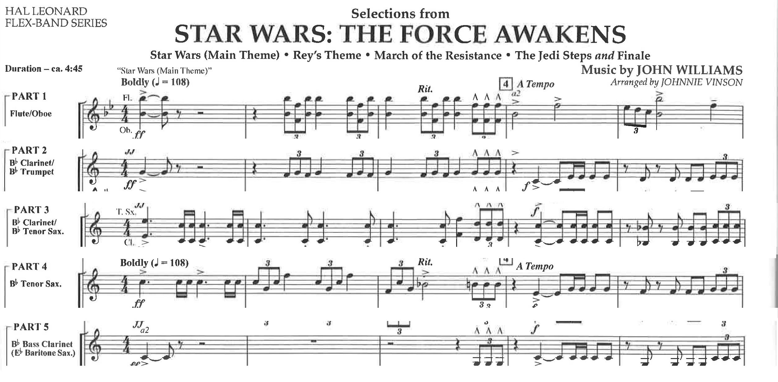

Slide 9
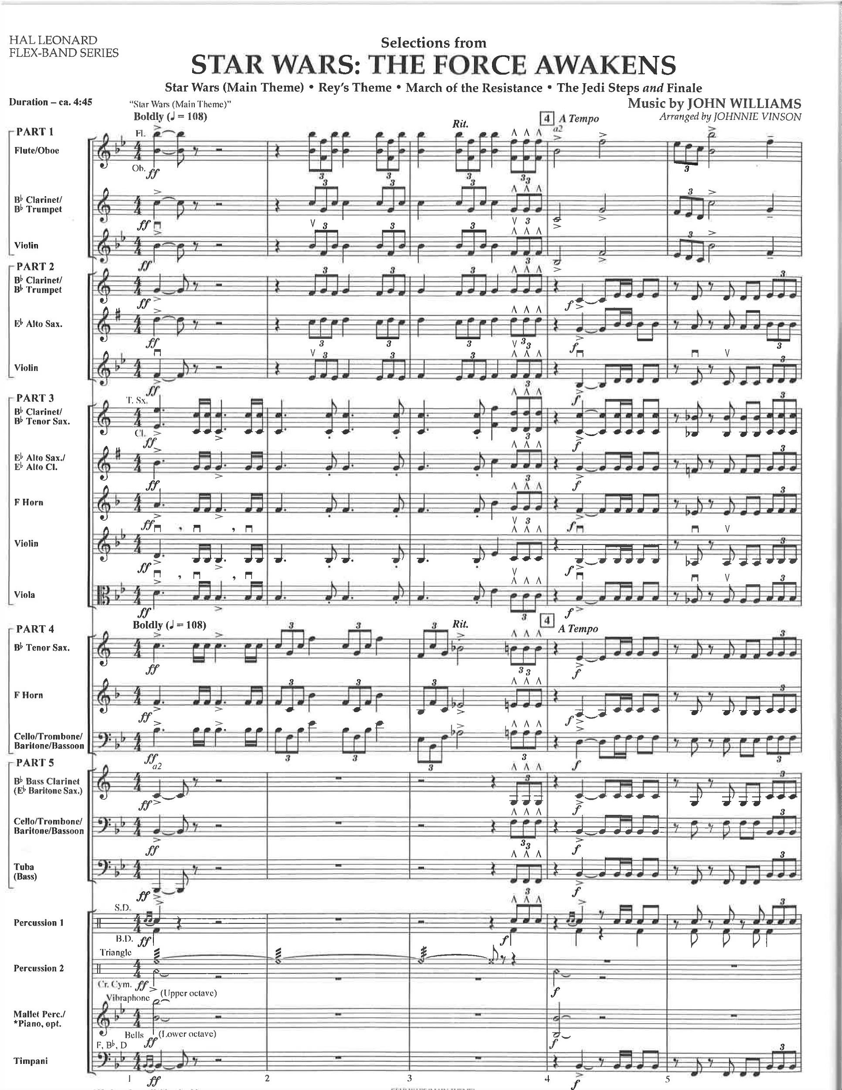

Slide 10
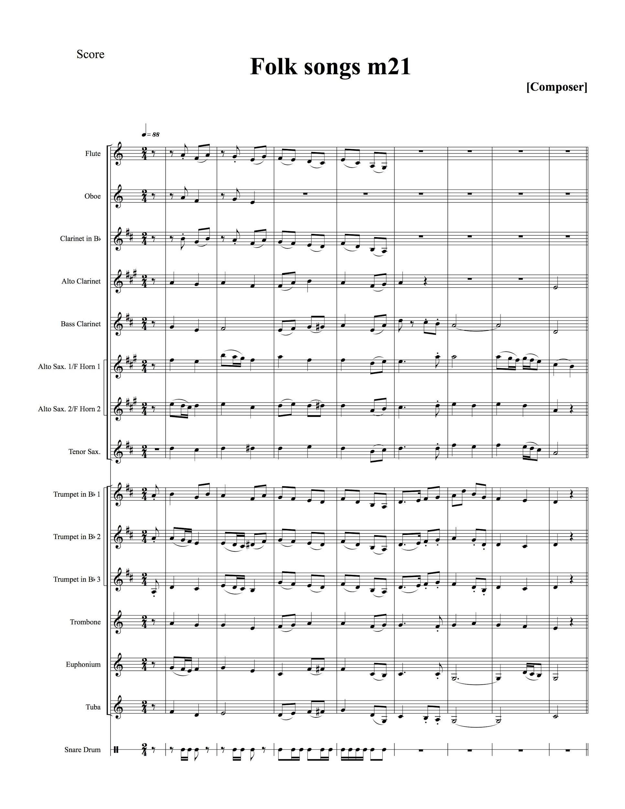
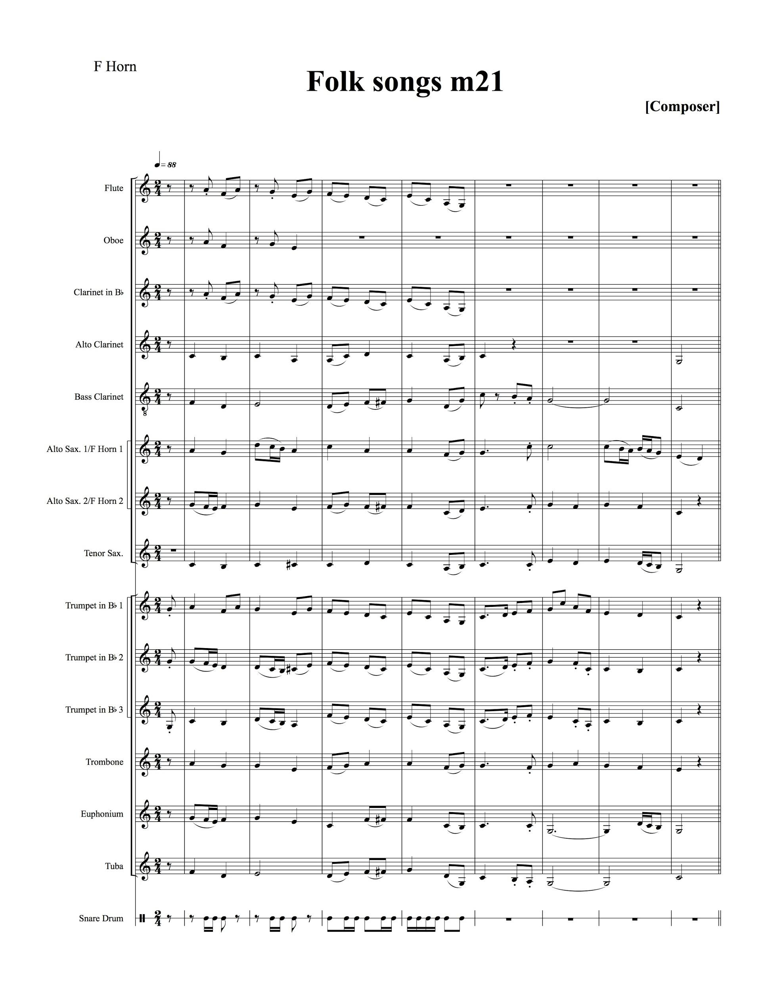

Slide 11
