Slide 1
Tips, tricks, and helpful ideas for teaching percussionists
Nathan Wilcox

Slide 2
GRIP and STROKE- everything starts with how they hold the stick!
“Dead Hand” (Relax)
Thumb directly across from the pointer finger
Thumb print on the stick (on the “TH” if using Vic Firth)
Nestle stick into the first joint of the pointer finger
Hands flat- thumb nails pointing toward each other
Roof top (90 degrees)
All motion comes from the wrist only- no elbow, no fingers (yet)
Rebound!
Start with full strokes- full range of motion
Don’t have them play soft until the grip and stroke are set

Slide 3
Practice Pads
Using practice pads, your drummers:
Learn to play with full wrist motion and technique
Still get full rebound from the drum
You can actually hear the rest of the band
You don’t have to have lots of equipment ($)
You can transition from full pad, to half pad, to no pad as they mature and get better
Without pads your drummers:
Get told all the time to play softer and don’t develop good technique
Play too loud all the time even though you just told them not to
If they did follow instructions and play softer, they develop pokey, weak technique

Slide 4
Start with the basics- ignore the method books
While the rest of your band is playing whole notes and learning embouchure, air support etc. DO NOT let your percussionists play whole notes, get them moving.
RRRR RRRR LLLL LLLL
RRRR LLLL RRRR LLLL
RRLL RRLL RRLL RRLL
RLRL RLRL RLRL RLRL
All full strokes, almost vertical stick heights, wrist motion

Slide 5
Sticking changes everything! (seriously… everything)
The simplest changes in sticking can make enormous impacts on success
Many kid’s who struggle can make instant improvements just by changing their sticking
What’s the point?
Everything starts with the right hand
Every time you see a specific rhythm, you play it the same way (1e+ = RLR)
Players recognize patterns better which enhances reading, especially sight reading.

Slide 6










Right Hand Lead: the RULES
ALWAYS start every measure or 8th note pattern or 16th note pattern with the RIGHT HAND
Exceptions: and

Slide 7
How to start:
1.
2.
3.
Have kids count rhythms out loud while they play- whisper rests
In the beginning, have them alternate between counts and R’s and L’s
Rests: Have kids progress from a full stroke “fake hit” to just a ”squeeze” to nothing at all (leaving the stick up)
Notes:
No volunteers yet- wait til slide 10

Slide 8
Syncopation by Ted Reed
Old school! patterns are patterns- don’t reinvent the wheel
It is versatile and has everything you will need to develop solid drummers.
It doesn’t include rolls, flams , or other advanced techniques, but you can make some simple tweaks to make those elements work while still using the book.

Slide 9
The progression:
Quarter notes- very small amount of time, just to introduce grip and stroke- move to 8th quickly
8th notes- Lots of time spent on these! This is where you build the muscle memory for all of the sticking rules. Everything else you do depends on these rules being understood and mastered.
16th notes- speed and evenness
16th notes- 1+a and 1e+ rhythms- think autopilot (we’ll get to that later)
Rolls- Use 16th note subdivisions for counting/feeling rolls
Accents- Introduce down strokes and upstrokes as opposed to full strokes
Flams- accents must be mastered before students learn flams

Slide 10
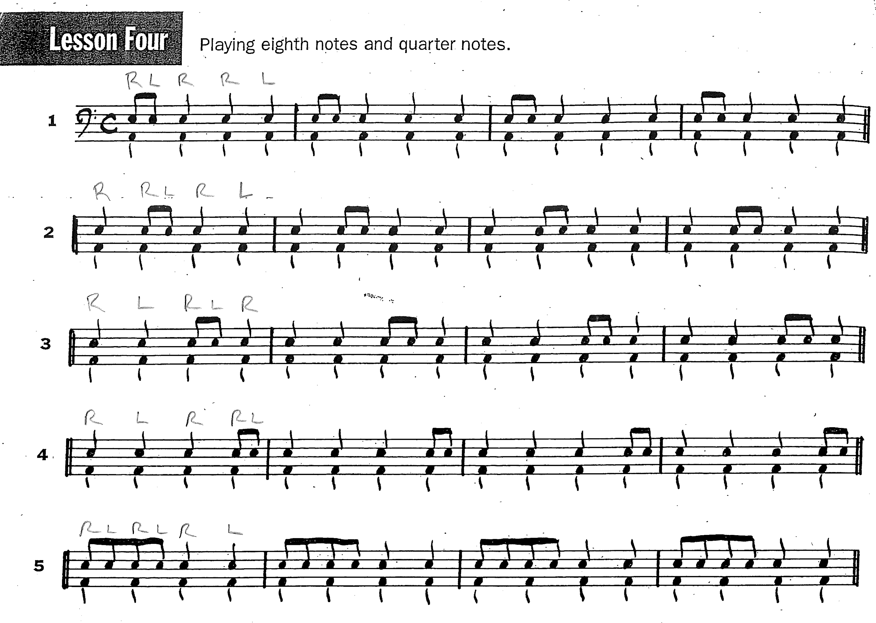
8th Notes- All about sticking
Play and Count
Play and Say R’s & L’s
Repeat
Mix it up by reading 2 measures of each line or even just a column
Remind, remind, remind them that every 8th note pair starts with RH
Notes:
Volunteers for practice and feedback (have a chair set up right behind the drums so they can sit down when I start to talk for a long time without them playing)

Slide 11
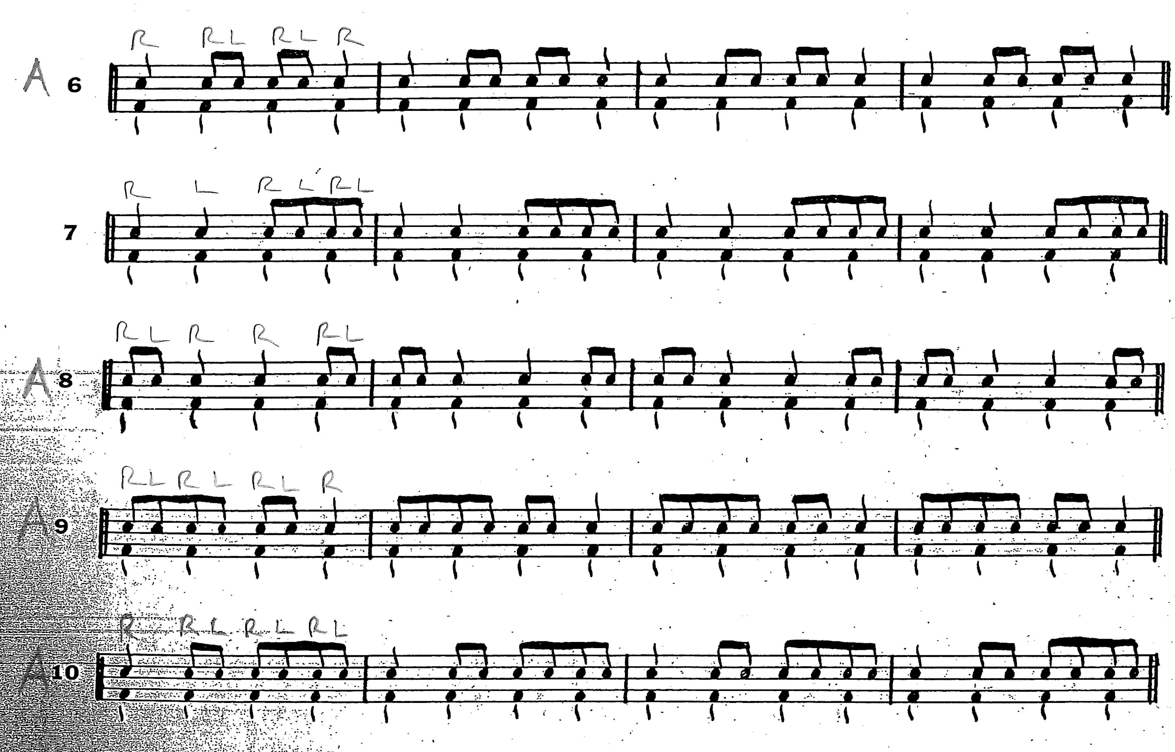
Autopilot- simplify
The right hand never stops
RH just plays quarter notes while the left hand determines the rest of the rhythms
Try a prep measure of just RH
Notes:
#9 don't let them downstroke on beat 4

Slide 12
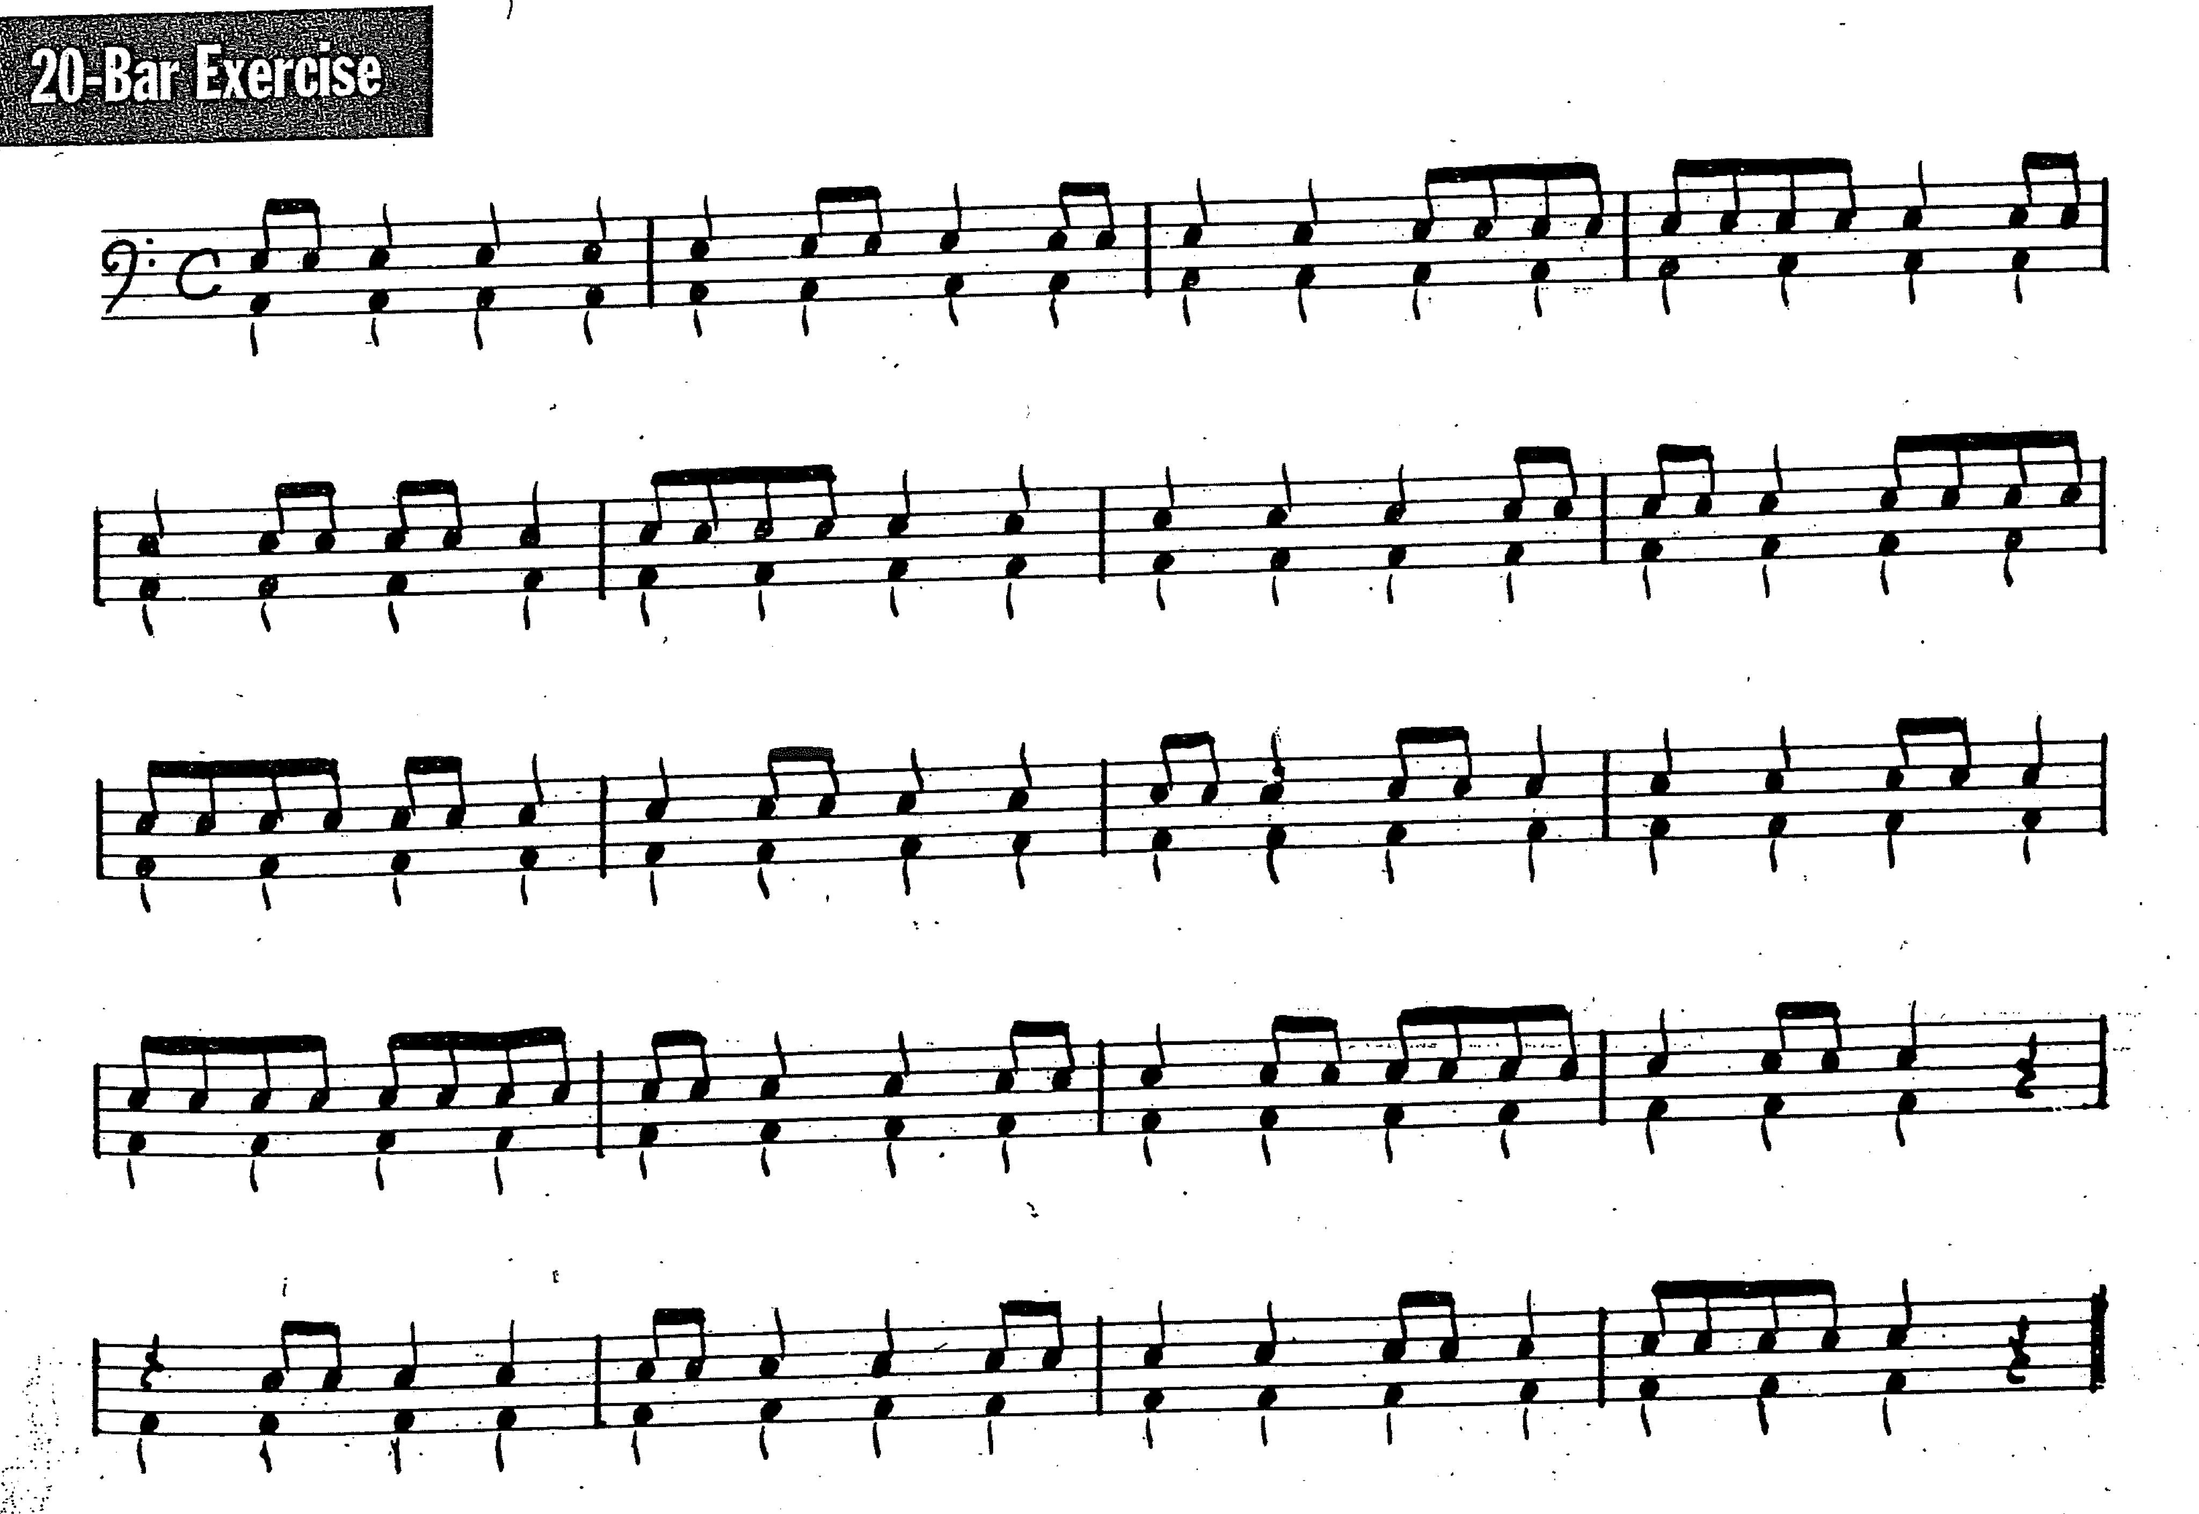
20 bar exercise: Summary of the past 2 pages
Repetition
Muscle memory
Do all of this while the rest of the band is playing out of their book
Just be flexible, quick mental math, and don’t worry when things don’t line up perfectly
Notes:
Same approach as before
-Count and play
-Say Rs and Ls and play

Slide 13
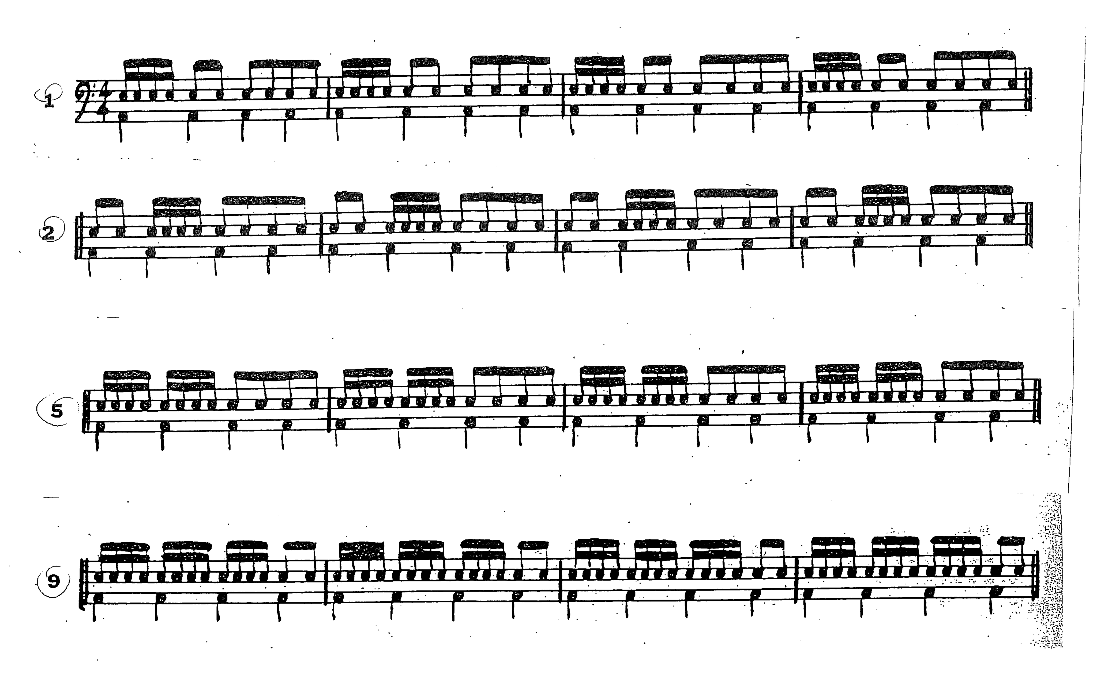
16th Notes- speed evenness
Play fast and listen and watch for even hands
Focus on stroke and stick heights
Watch for french grip (drum set players especially)
Relaxation, not tension
Separate RH, LH
Notes:
-Mention heavy right hand side effect to this approach, it's still worth it. Just harp on bringing the left hand up.
-have the group play #9 with RH only and gradually speed them up.

Slide 14
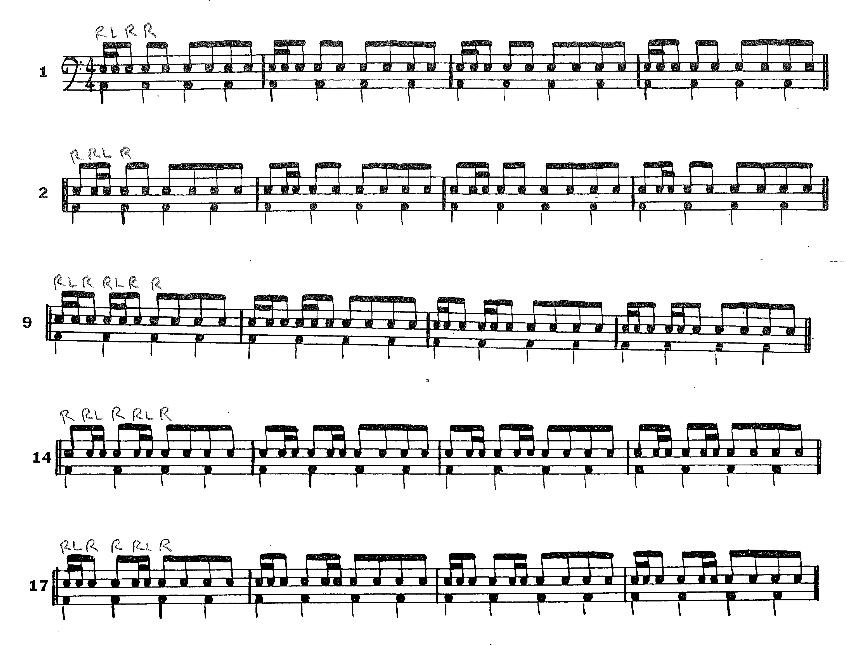
Other than on the first 8th note patterns and sticking rules, you’ll spend the most time here
Reinforce sticking rules
Separate out RH, LH to get them to feel autopilot
As soon as they hit 8th notes again, snap back to easy RLRL concept
Notes:
-Present this to the kids as patterns they're already learned
-Same progression- count/play, R&Ls/Play

Slide 15
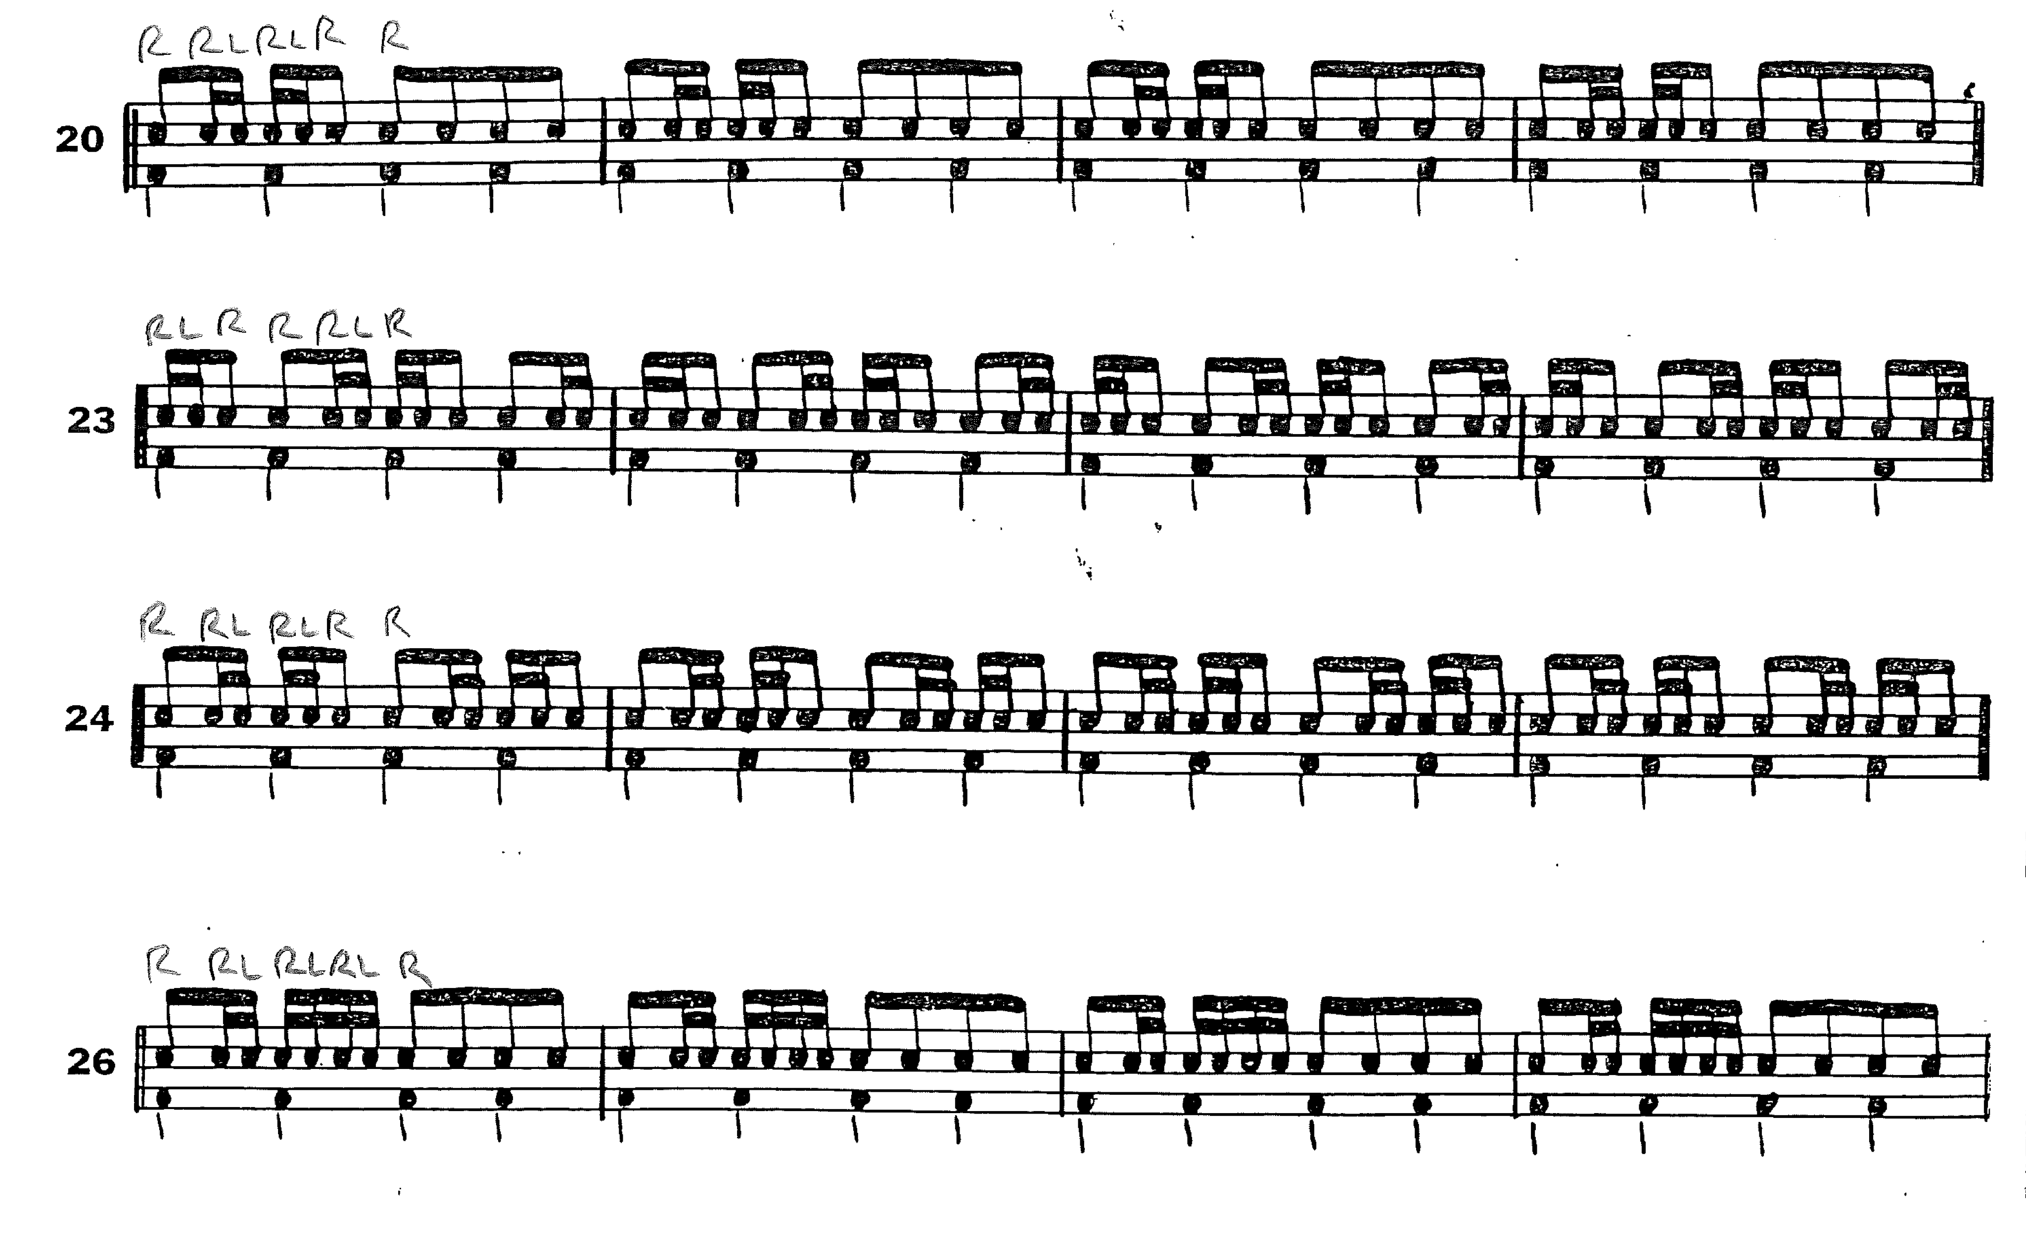
Don’t forget the grip and stroke
Constantly reinforce these while still focusing on sticking
Make sure students count out loud while playing
Autopilot

Slide 16
Rolls- recycle the 16th note page
16th=buzzes
This helps them subdivide their rolls
SLOW DOWN!
It is about how many buzzes you can get with each stroke, NOT how fast your hands move
Don’t change the grip! The fulcrum is crucial, but…
Try to keep back fingers on the stick

Slide 17
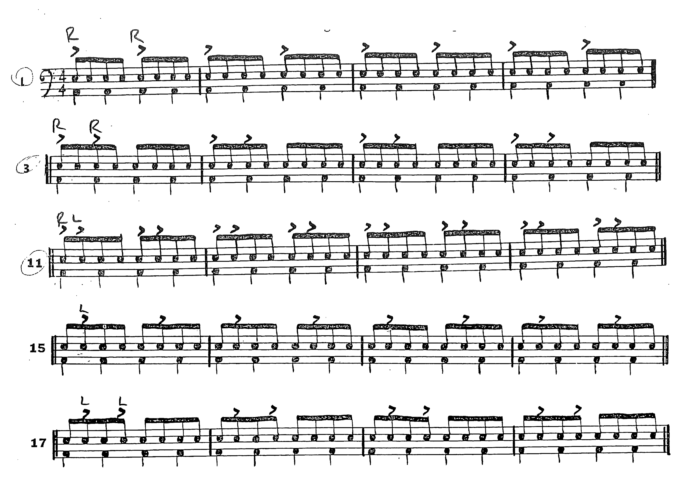
Accents
Everything alternates, focus on which stick hits the accent
Define down stroke, up stroke, vs. full stroke
Break down what each hand is doing
I draw arrows on the board to help visualize up v. down v. full strokes
Notes:
Have the volunteers sit back down

Slide 18
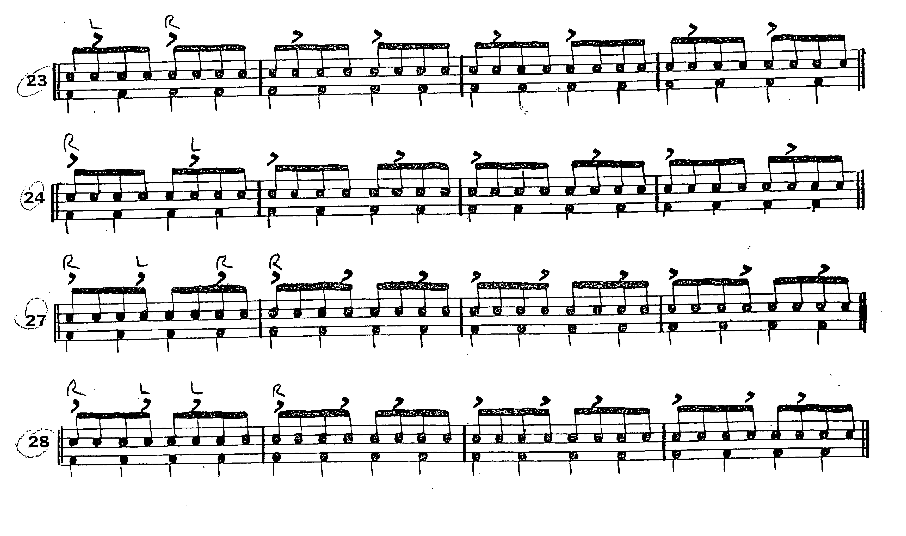
More Accents
The upstrokes the prep for an accent are vital
Don’t let kids “whip” the stick for accents
The lower the down stroke, the better

Slide 19
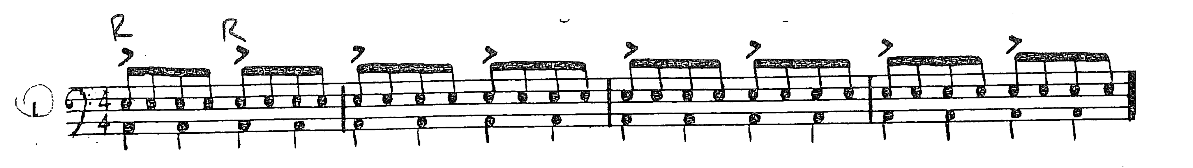
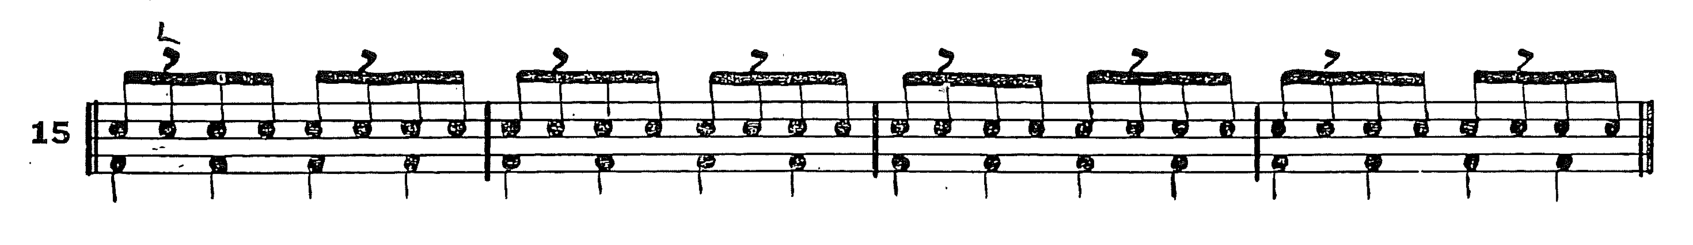
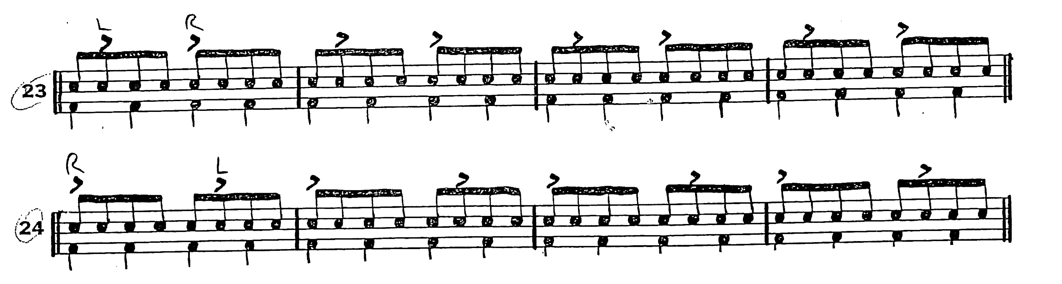
Flams- recycle accent page
Play accents only, then add the flams
Keep the sticking exactly the same other than adding the grace note
The note following the flam is often wrong
Flams are all about stick heights
The same general ideas apply for flams as they did for accents
Don’t let kids “whip” the stick for flams/accents
The lower the down strokes, the better

Slide 20
Schmoker- Leading with Focus
“Doing less and doing it better”
Focus on one thing that makes a difference and do that one thing amazingly well. Be ridiculously clear and unbelievably persistent at reminding everyone of what is expected, don’t let it fade away
Harp, remind, hound, badger, repeat. Do whatever it takes to drive home the importance of your “one thing”
For me, this is sticking, plain and simple
Sticking solves 90% of your percussionists’ problems

Slide 21
Drumming Questions?
What about lefties?
Either tell them to deal with it and do it all right handed anyway
Or, have them completely flip everything
What if my kids have flams or rolls in sheet music but we haven’t gotten there yet in the progression?
Choose: Depending on the kid, just have them leave it out, or give them a crash course on that one element. Have them watch one of the Perc 101 videos at vicfirth.com
Other Drumming Questions?

Slide 22
How do I get my drummers to play mallets too?
Great question!
First, don’t even teach them dots, teach them the scale by rote and get them feeling good about playing keyboards. Build some confidence (then crush it later when they realize they don’t know what they’re doing). By then, at least you’re just taking their confidence down a notch rather than starting from rock bottom. It’s subtle, but there’s a difference
Build muscle memory for the scale then work on peripheral vision
Build these skills so they can actually learn how to read instead of just memorizing and staring straight down

Slide 23
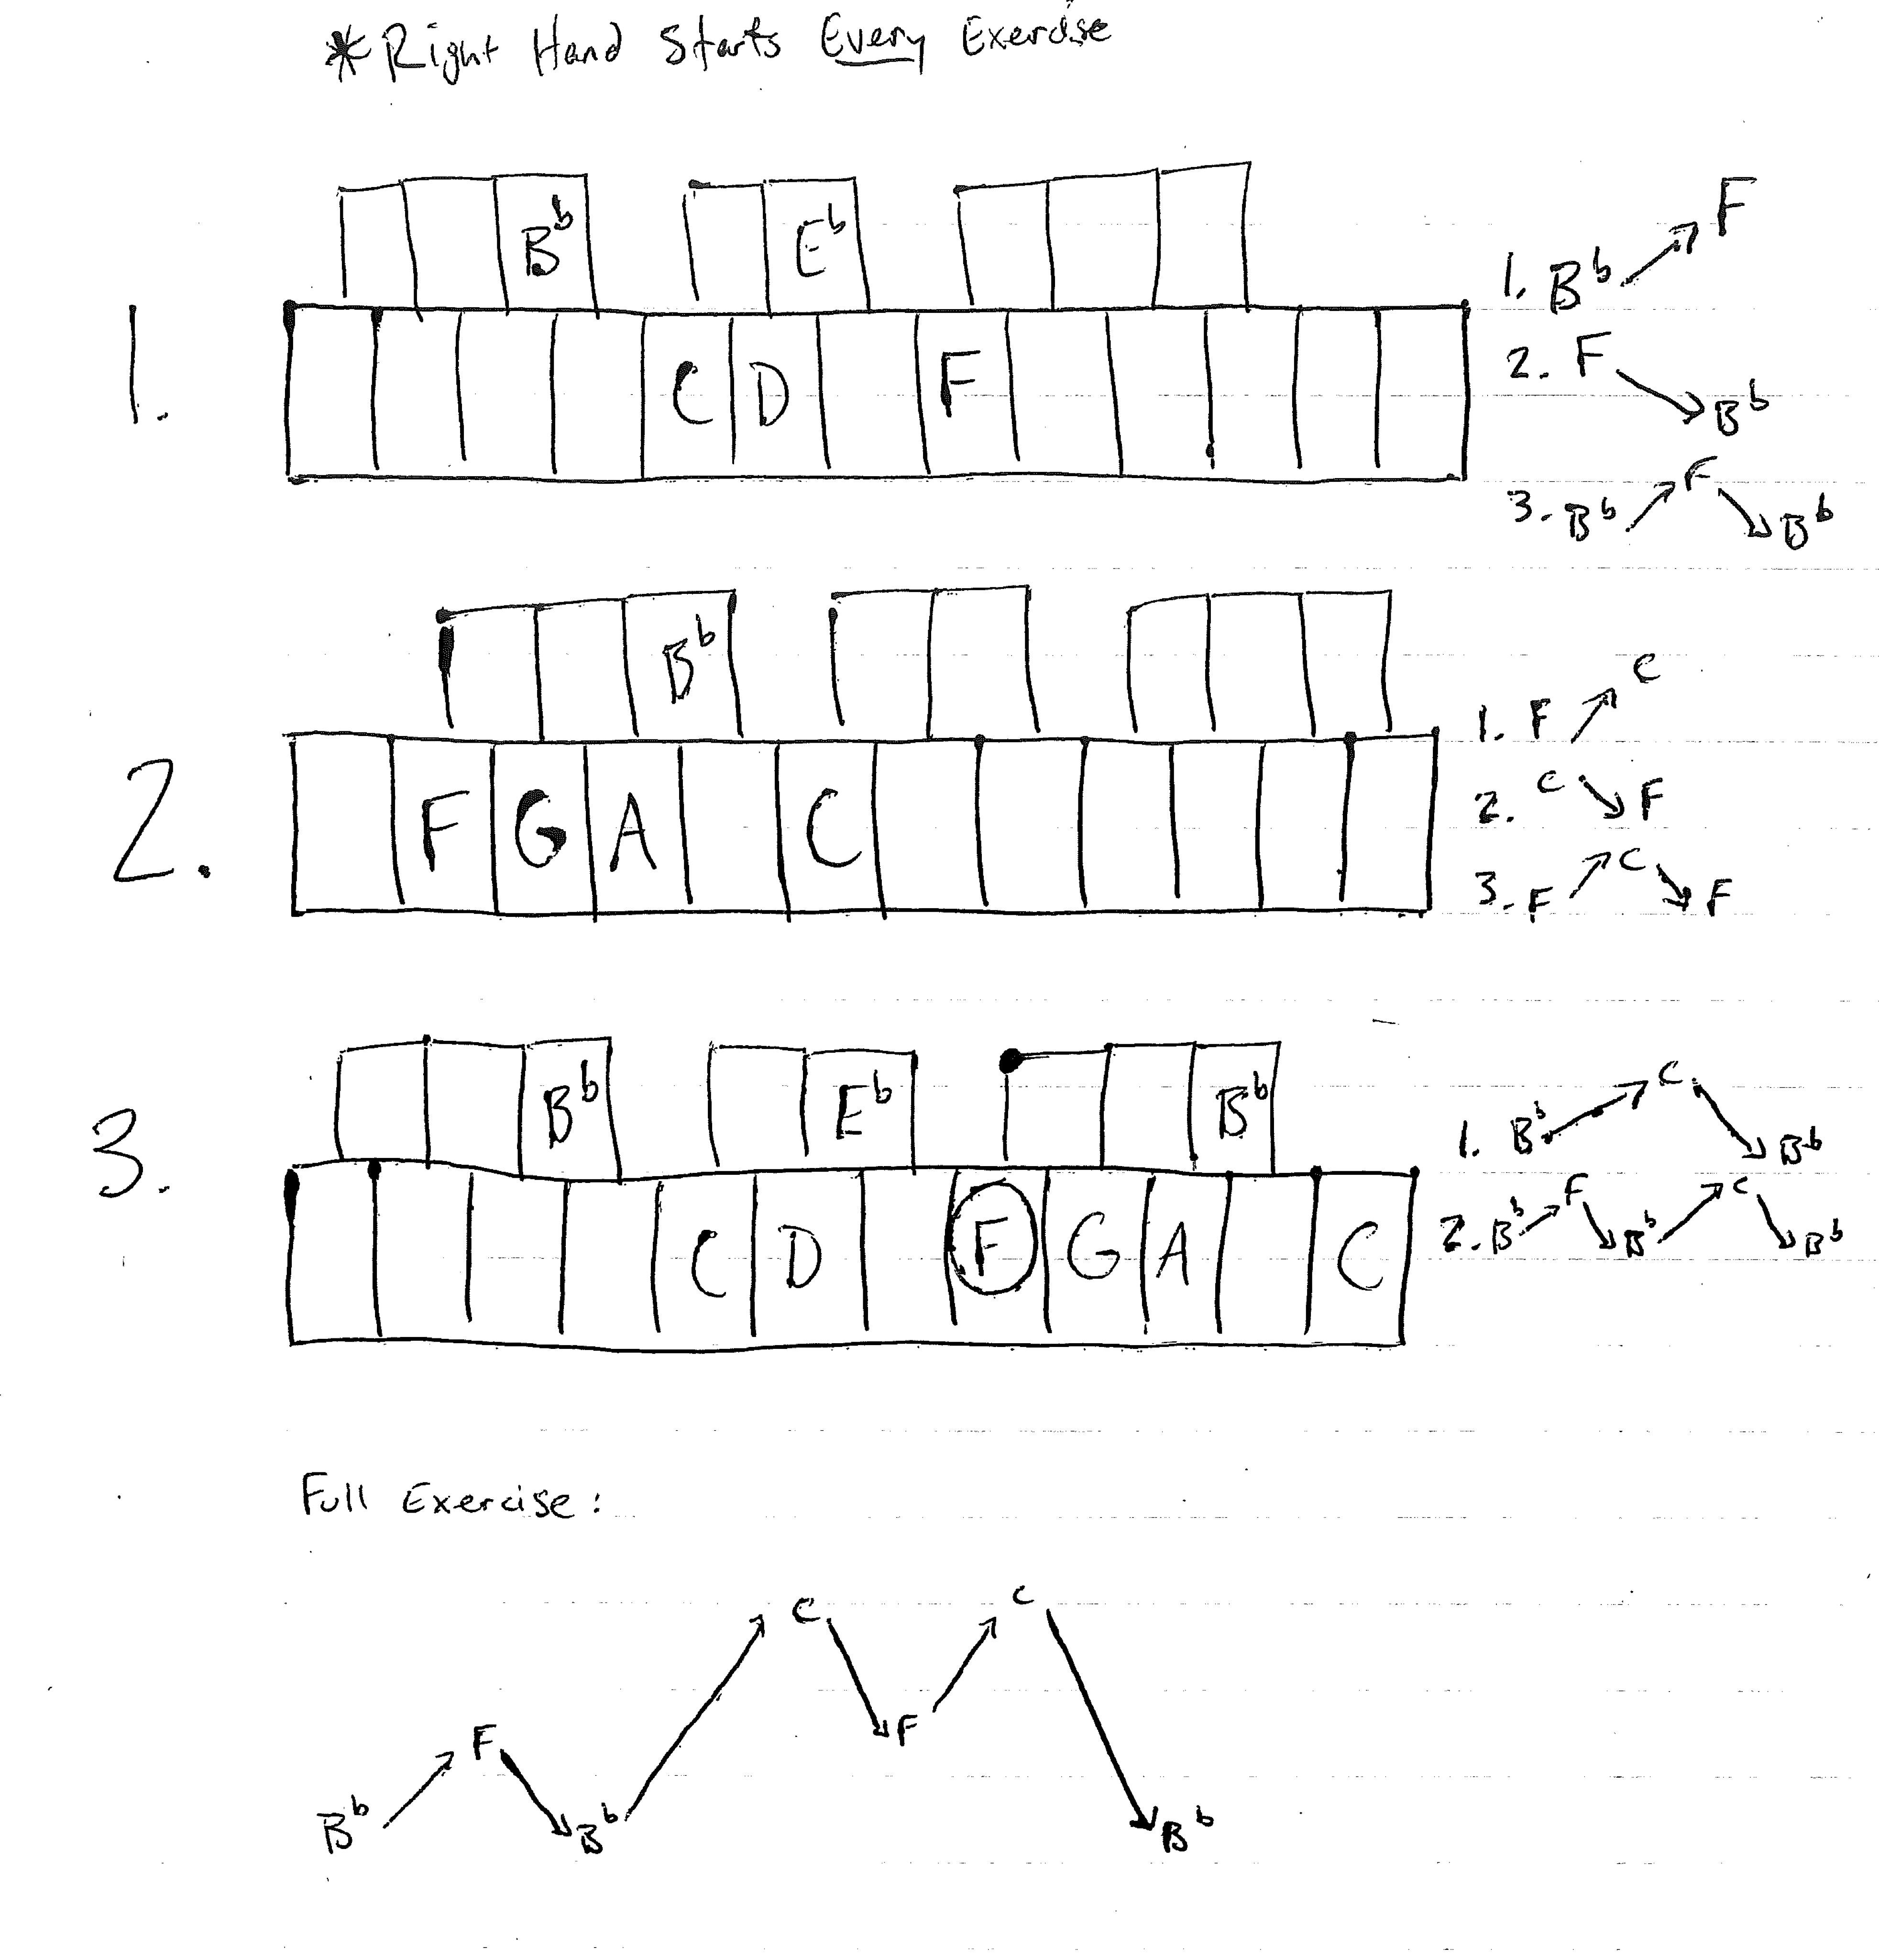
The Basics- when they can’t even find a Bb!
Start by using simple patterns (all lead by the right hand of course)
This is just getting them comfortable with how the hands move around the Bb scale
It is a fun scale and they will actually get excited about paying “bells”
Start with slow quarter notes, then move up to 8th notes.
Challenge the kids for speed

Slide 24
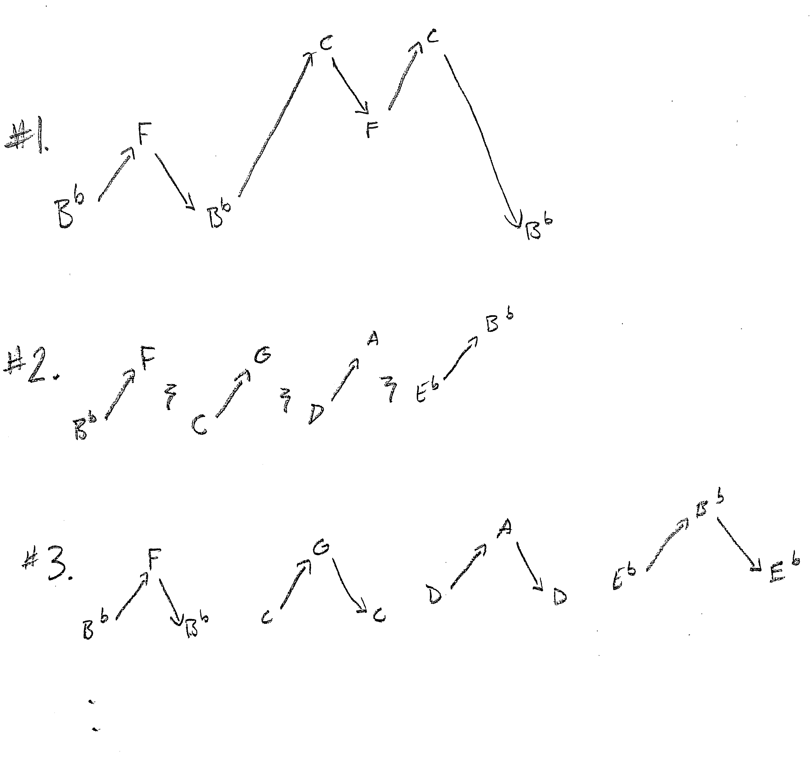
More patterns
Patterns 2 and 3 get the kids starting on different notes so they get an even better feel for how the scale works regardless of which note starts the pattern.
It is easy to make these short patterns fit into what the rest of the class is doing. (4-8 measure book exercises)
Have them play these exercises while looking up at a stand or the edge of the bars to develop confidence using peripheral vision

Slide 25
Actually reading music- drummers can do that?! (not just that one girl who already reads notes…)
Peripheral vision is key
They have to trust themselves to play without looking down
Start insanely slow- say out loud: ”Bb, up” hit, “up”, hit “down” etc.
Then work up to quarter notes, then 8th notes
Be patient, give them appropriate praise- this is HARD!

Slide 26
Wait a second… they still don’t know how to read!
While learning “ups and downs”, have them say letter names
They will get progressively better at reading and trusting their peripheral vision.
Remind them that it is better to play the wrong notes and keep their eyes up than it is to just memorize it and stare down (unless it’s a really tough part that they need to stare down for)
Once they are comfortable with scales, start introducing skips (only 3rd at first, then bigger and bigger until they are really reading music
Start with mallets then use drumming as a carrot
Students who can master these mallet exercises can move on to drumming

Slide 27
Sight Reading Factory
SRF is a great program that allows you to create unlimited sight reading examples
Set parameters to keep it simple or push the envelope
Customize everything, develop your own exercises without having to scramble to find the ones I included earlier
Relatively inexpensive for how useful it can be

Slide 28
Mallets- Sticking rules still apply (at least as much as possible)
In general:
Try to start each measure on the right hand
Try to alternate scale patterns as much as possible, even if it feels awkward at first
First, have students play the rhythm on one note so they feel how they would stick it on one drum, then try to use that same sticking around the bars
If there is an issue, then explore a better way

Slide 29
Mallets- Technique still matters
Grip should be exactly the same
Students should think of the same rebound as on a drum but they have to use the wrist to make it happen
Avoid the ”node” (the spot where the rope goes through the bar) it sounds like junk. Hit the center of the bar over the resonator or the very edge.
For faster passages, have students play the edges
Where to strike the bar

Slide 30
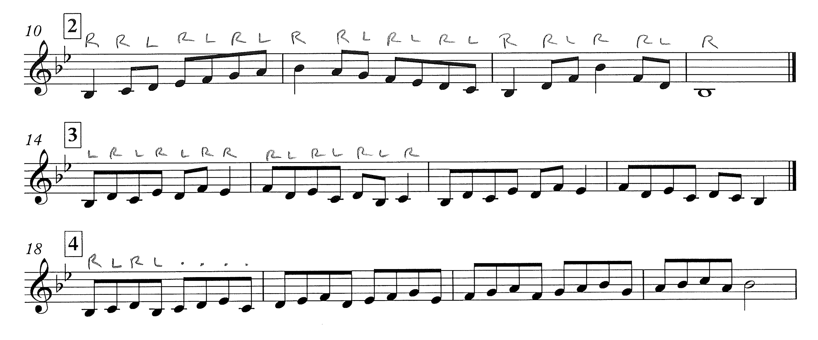
Some examples- rules and exceptions

Slide 31
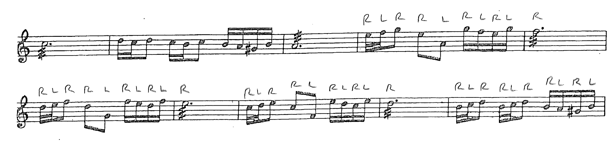
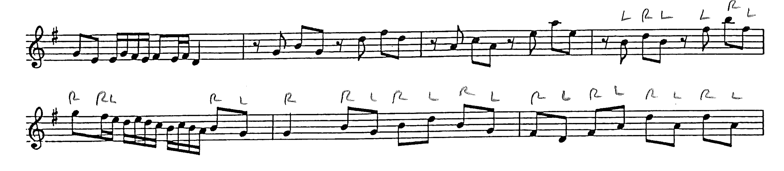

Slide 32
More advanced drumming ideas
Triplet sticking rules
A great way to teach quarter note triplets
The idea of left hand autopilot

Slide 33
6/8 sticking rules
Similar to 4/4 in triplets, but the R RL L swing feel is unique to 6/8 and can dramatically help drummers feel the meter better

Slide 34
Drumline- Traditional Grip vs Matched?
Matched grip is better because you use it for everything, they don’t need to learn another grip
Traditional grip is finicky and if you don’t have very good teaching, the technique suffers greatly. Most kids do it wrong, rolls especially
It sure looks cool, but is it worth it? …NO (especially unless you really know what you’re doing)
MSU’s take on self-taught traditional grip- this happens more than you’d think

Slide 35
Accessories
Accessories- teach kids specifics and they will take ownership more and take better care of the instruments. It becomes something more important than “just the tambourine” when they know the “right” way to play it
Even if you don’t know the specifics and don’t remember the details from the videos, make them available to the kids to they can watch them
http://vicfirth.com/percussion-101/
Look for “tamb, sus cymbal” vs “tamb/sus cym”
Commas mean two different players, slashes mean 1 player can play both
These can help you assign parts faster
Assign parts for your percussionists at least in elem/MS so it forces them to play different instruments. Encourage growth as percussionists, not just “drummers” and that one girl who plays bells on everything.

Slide 36
Timpani
Grips
At the level most of us are teaching, it’s more about the rebound than the grip itself
French/German/American grips
Just like on everything else, match grip just works better for everything
Maintenance
Don’t let students use it as a table!
Make sure the head is tuned the same at each lug
If the pedal is slipping toward the toe, tighten the head
If the pedal is slipping toward the heel, loosen the head

