Slide 1
“Curriculum is not a Dirty Word using the State Standards in the Band Room”
Clinicians:
Combs, Loftus, Molyneaux

Slide 2
Timeline
1994 – MENC (NAfME) National Standards For Arts Education - Dance, Music, Theatre, Visual Arts
1999 – Previous MT Standards Adopted
2014 – National Coalition for Core Arts Standards
Dance, Media Arts, Music, Theatre, Visual Arts
2016 – Montana Board of Public Education Adopts
Montana Arts Content Standards
(adding Media Arts domain)
2024 – Next Review of MT Arts Standards
Notes:
Mini bio

Slide 3
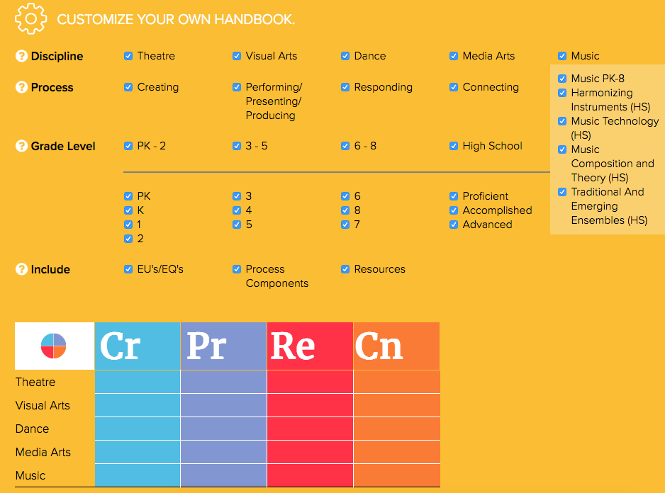
NCCAS - 2014

Slide 4
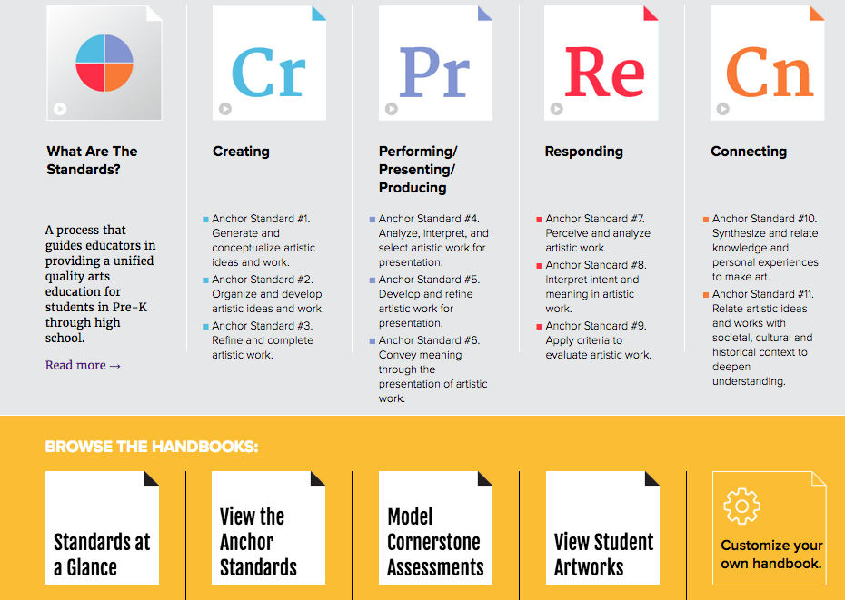
OVERVIEW

Slide 5
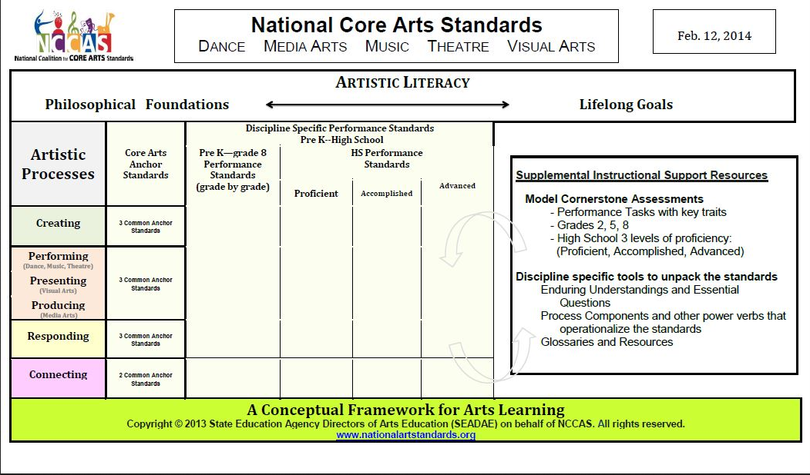
OVERVIEW

Slide 6
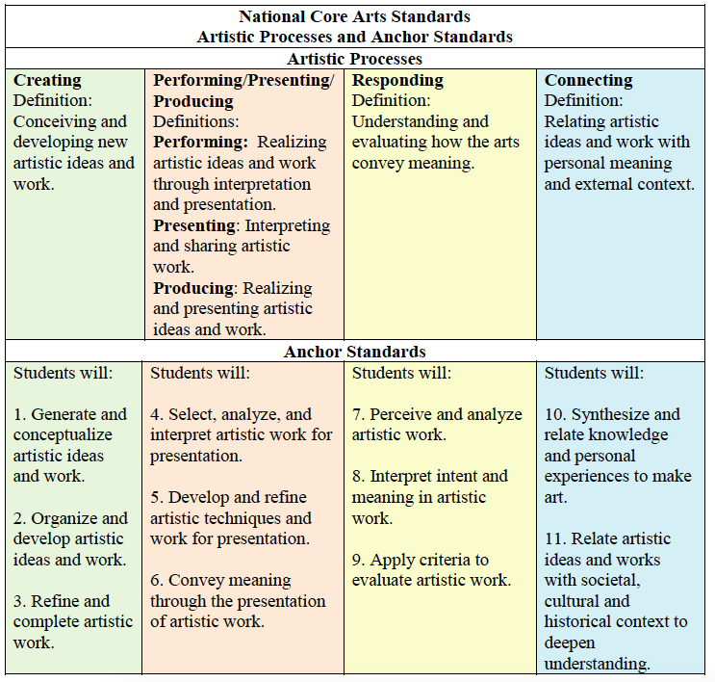

Slide 7
OVERVIEW
Discipline/Domain (e.g. Music)
Process (e.g. Creating)
Anchor Standard (e.g. 1 Generate and conceptualize artistic ideas and work. )
Grade Level(s)

Slide 8
OVERVIEW - NCCAS

Slide 9
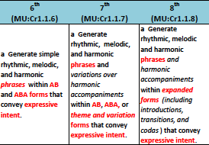
OVERVIEW - NCCAS

Slide 10
OVERVIEW – MT 2016

Slide 11
OVERVIEW – MT 2016

Slide 12
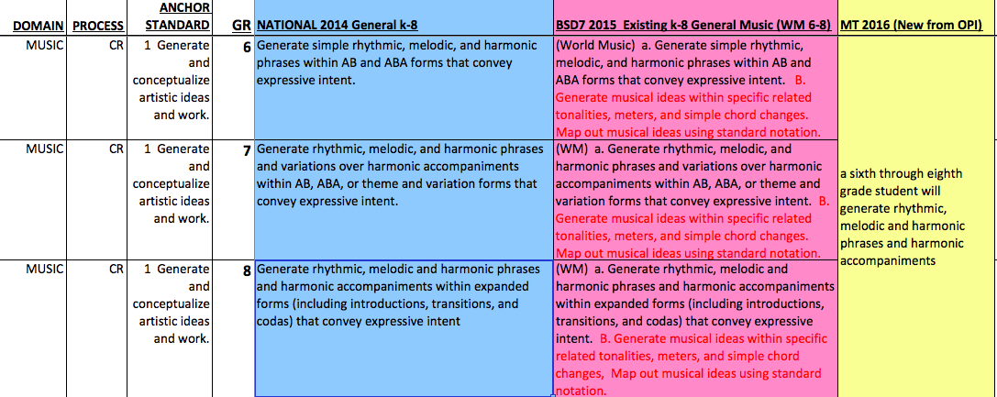
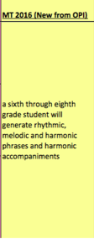
OVERVIEW - crosswalk

Slide 14
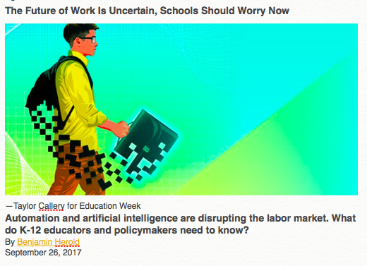
Wages for highly educated people have gone up, because information technologies complement the creative, problem-solving, and managerial work they tend to do.

Slide 15
The Future of Work Is Uncertain, Schools Should Worry Now
Taylor Callery for Education Week
Under President Barack Obama, the White House concluded that automation will likely continue to erode the fortunes of workers who don't have a high school diploma and who earn less than $20 per hour. The National Academies of Science, Engineering, and Medicine, meanwhile, warned that technology will begin eating away at jobs currently filled by some highly educated workers.

Slide 16
The Future of Work Is Uncertain, Schools Should Worry Now
Taylor Callery for Education Week
Then there's this: As the future-of-work conversation evolves, many analysts are focusing on the specific tasks, rather than the entire occupations, that technology will likely take over from humans. An analysis this year by the McKinsey Global Institute, for example, estimates that existing technologies could be used to automate roughly half of all the activities that workers are currently paid to do.

Slide 17
The Future of Work Is Uncertain, Schools Should Worry Now
Taylor Callery for Education Week
In the crosshairs: anything that involves routine physical motions, operating machinery in predictable environments, or collecting and processing data.

Slide 18
The Future of Work Is Uncertain, Schools Should Worry Now
Taylor Callery for Education Week
If that's how things play out, today's students are going to need a new set of skills, regardless of what field they enter.

Slide 19
The Future of Work Is Uncertain, Schools Should Worry Now
Taylor Callery for Education Week
Every young person entering the 2030 labor market might need a solid grounding in statistics and data science, the thinking goes. Farmers, for example, would need to make sense of torrents of data generated by sensors and drones on soil and weather conditions.

Slide 20
The Future of Work Is Uncertain, Schools Should Worry Now
Taylor Callery for Education Week
To maintain their edge, workers would also need to focus on cultivating the human qualities that robots still lack, such as creativity, empathy, and abstract thinking.

Slide 21
The Future of Work Is Uncertain, Schools Should Worry Now
Taylor Callery for Education Week
And because most jobs could constantly evolve, today's students could eventually face a make-or-break question: Can you adapt?

Slide 22
The Future of Work Is Uncertain, Schools Should Worry Now
Taylor Callery for Education Week
"I don't think there's any way we can accurately say what skills and competencies students will need 15 years from now," said Michael Chui, a partner at the McKinsey Global Institute. "That's why it's incumbent that we prepare young people for a world of constant uncertainty."

Slide 23
Success in the Modern World
(Growth) Mindset
Creativty
Adaptability
Problem-Solving
People (soft) skills
Finding/Asking Good Questions

Slide 24
I choose “C”

Slide 25
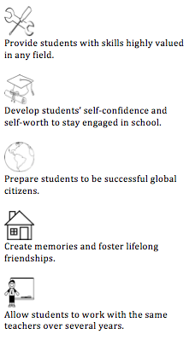

Slide 26
Responding Standards in the Band Room
Some ideas for Assessments in a group setting

Slide 27
Responding Standard 7: Perceive and Analyze Artistic Work
5th Grade: cite evidence that connects musical selections to specific experiences
Why don’t we sing “You’re a Mean One, Mr. Grinch” on Valentine’s Day?
Assessments: Music for holidays, celebrations, ceremonies. Easily done with a multiple choice/matching exercise

Slide 28
Responding Standard 7: Perceive and Analyze Artistic Work
6-8th grade: compare connections between musical selections for a specific purpose
What makes a good program? Is Salute to Swearingen! a great concert theme?
Talk about variety/style, different composers/arrangers, different key centers/tonalities, tempos.
Have kids design a program for a hypothetical event that you design. Have them select the literature for a real program—you pick the songs that are eligible, they design the order and defend why they include it.

Slide 29
Responding Standard 7: Perceive and Analyze Artistic Work
9-12th grade: analyze elements of music in selected works for specific responses
Why does Grainger’s Irish Tune make me cry?
Easily done with journal/short response. Pick a song from folder, have them discuss Tempo, Dynamics, Tonality, Expressive Markings. How does the composer use all of these to convey mood/emotion

Slide 30
Responding Standard #8: Construct meaningful interpretations of artistic work.
5th Grade: describe how performers interpret expressive intent in music
Why is Adele so popular? Why aren’t Lullabies shouted to babies?
Easily assessed with dynamic work for playing tests, or matching test for written sample. Or have them add dynamics to a piece/line in method book and defend their choice.
Choose the dynamic marking that is best for the style of music:
Lullaby
Marching Band
Country Ballad
Rock Concert

Slide 31
Responding Standard #8: Construct meaningful interpretations of artistic work.
6-8th grade: Compare how composers and performers interpret expressive qualities of music to create performance
Why does all of Robert W. Smith’s music sound the same?
Compare/contrast with two pieces in folder. Easy!

Slide 32
Responding Standard #8: Construct meaningful interpretations of artistic work.
9-12: analyze composers' and performers' expressive intent in interpretations of music
Can combine Anchor Standard 7-8 in one assessment! Easily done with journal/short response. Pick a song from folder, have them discuss Tempo, Dynamics, Tonality, Expressive Markings. How does the composer use all of these to convey mood/emotion
OR Listen to two different recordings of the same piece. What is the same? What is different? Which one do you like better and why?

Slide 33
Responding Standard #9: Apply criteria to evaluate artistic work.
5th Grade: use established criteria to evaluate the quality of musical works and performances
How come the Seniors sound better than the 8th graders?
Easy to assess: Rubrics. Start simple—2 or 3 things to listen for. Grade their own performance, grade the group performance.

Slide 34
Responding Standard #9: Apply criteria to evaluate artistic work.
6-8: develop criteria to evaluate musical works and performances
Why is the recording so much better than us?
Establish the 4 T’s: Tone/Tuning/Tempo/Technique. Make rubrics! Evaluate self/section/groups.
Lead them into…

Slide 35
Responding Standard #9: Apply criteria to evaluate artistic work.
9-12: develop criteria to analyze the technical and expressive qualities of music and performances
Why did we get a II at Festival?
District Festival Forms!!!!! Use them in class. Draw a line through the circle, evaluate yourself on one side and the section or group on the other. What would you do to fix the problems you hear? What positive comments would you leave?

Slide 36
Teaching to Standards is just good teaching. The big shift is that we need to think more about individual growth, and still keep the ensemble growth in mind.

Slide 37
Which is true?
The Band will be better if I conduct/rehearse them better.
The Band will be better if you have better players with broad based skills.

Slide 38
The Answer is both statements are true!
Standards help you get to both.

